Slide 1
Linearization Explains Fine-Tuning in
Large Language Models
EECE695D : Deep Learning Theory
NeurIPS 2025
Group 1
JoonSeok Kim
Yong Jun Kim

Slide 2
Section 1 : Motivation
EECE695D : Deep Learning Theory

Slide 3
Motivation
- PEFT : Technique to reduce the effective number of trained parameters
- Choices : Update only a few layers, apply rank-limited updates
Objective of research : Proximity of the fine-tuned models to the pretrained models promotes linearity. Based on this one can predict performance of various fine-tuning decisions using the properties of NTK kernel
Idea 1. Fine-tuned models are encouraged to remain close to the pretrained model
Idea 2. This restriction (regularization) can achieve linearization
Idea 3. Through this linearization, we can learn fine-tuning using the NTK kernel properties
→ Linearized fine-tuning
What the paper shows compared to previous works
  Quantify the extent to which linearity is preserved during fine-tuning
  Theoretical upper bound on the distance between the fine-tuned model and its linearized approximation
Afzal, Zahra Rahimi, et al. "Linearization Explains Fine-Tuning in Large Language Models." The 39th Annual Conference on NeurIPS.

Slide 4
Section 2 : Problem Formulation
EECE695D : Deep Learning Theory

Slide 5
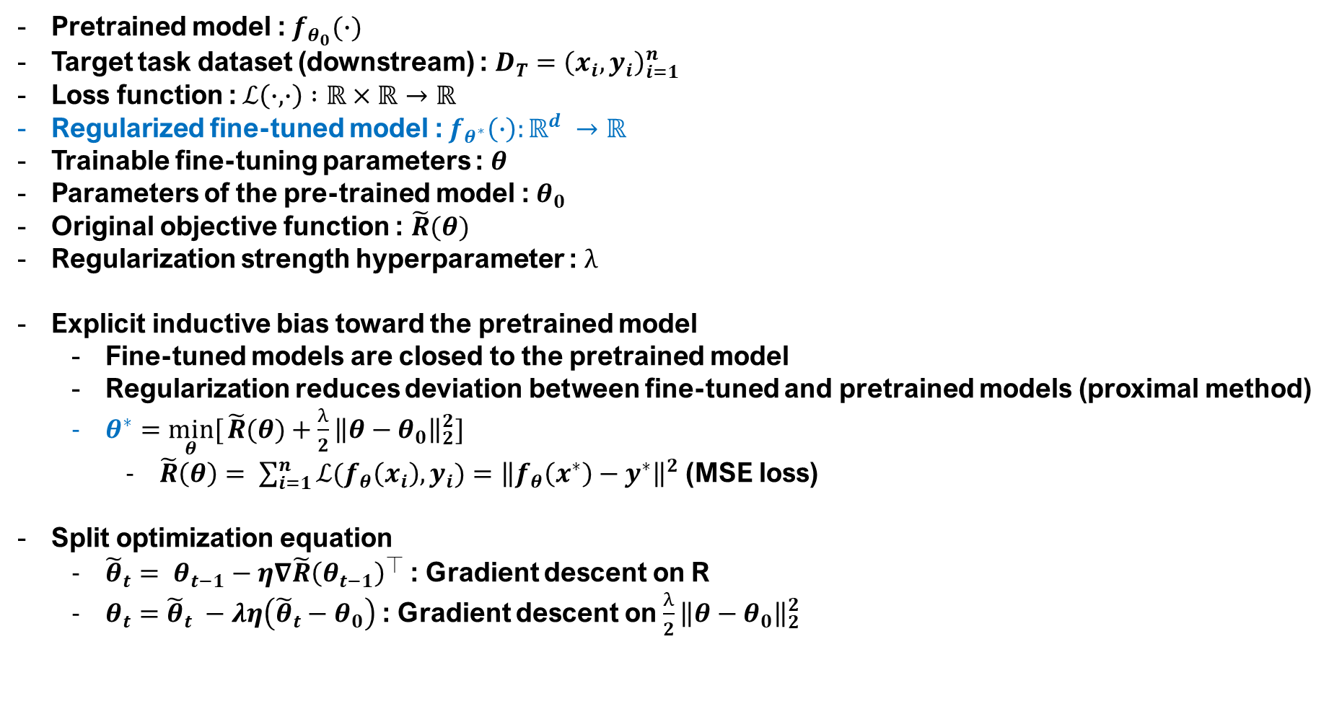
Problem Formulation
Pretrained model : $f_{θ_{0}}(∙)$
Target task dataset (downstream) : $D_{T}={\left(x_{i},y_{i}\right)}_{i=1}^{n}$
Loss function :$ℒ\left(∙,∙\right) :ℝ×ℝ→ℝ$
Regularized fine-tuned model :${ f}_{θ^{∗}}\left(∙\right):ℝ^{d} →ℝ$
Trainable fine-tuning parameters : $θ$
Parameters of the pre-trained model : $θ_{0}$
Original objective function : $\tilde{R}(θ)$
Regularization strength hyperparameter : $λ$
Explicit inductive bias toward the pretrained model
  Fine-tuned models are closed to the pretrained model
  Regularization reduces deviation between fine-tuned and pretrained models (proximal method)
  $θ^{∗}=\min_{θ}[{\tilde{R}(θ)}+\frac{λ}{2}{\left\|θ−θ_{0}\right\|}_{2}^{2}]$
    $\tilde{R}\left(θ\right)= \sum_{i=1}^{n}{ℒ(f_{θ}\left(x_{i}\right),y_{i})}={\left\|f_{θ}\left(x^{∗}\right)−y^{∗}\right\|}^{2}$ (MSE loss)
Split optimization equation
  ${\tilde{θ}}_{t}= θ_{t−1}−η∇\tilde{R}{\left(θ_{t−1}\right)}^{⏉}$ : Gradient descent on R
  $θ_{t}={\tilde{θ}}_{t} −λη\left({\tilde{θ}}_{t}−θ_{0}\right)$ : Gradient descent on $\frac{λ}{2}{\left\|θ−θ_{0}\right\|}_{2}^{2}$
Afzal, Zahra Rahimi, et al. "Linearization Explains Fine-Tuning in Large Language Models." The 39th Annual Conference on NeurIPS.
Notes:
Fine-tuned model is regularized

Slide 6

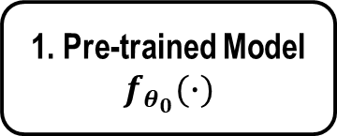

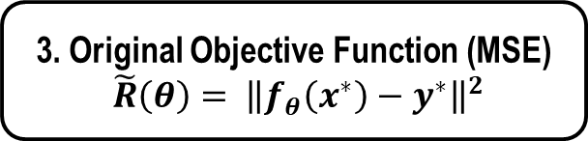
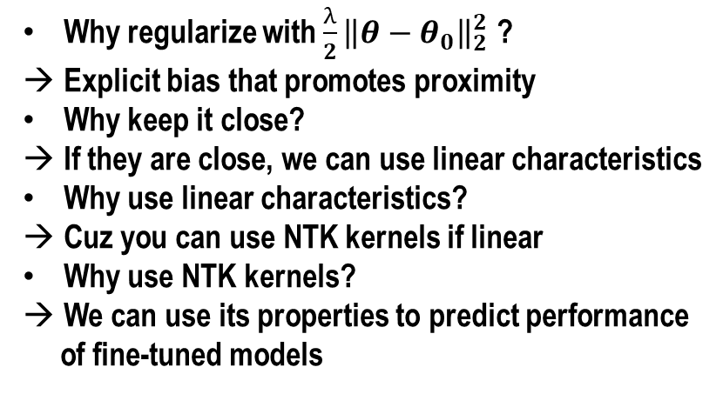
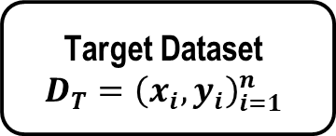
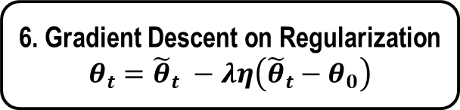

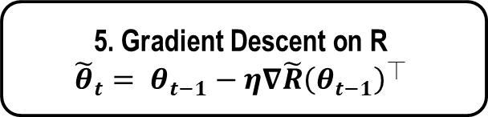
Problem Formulation : Additional Slide
Why regularize with $\frac{λ}{2}{\left\|θ−θ_{0}\right\|}_{2}^{2}$ ?
Explicit bias that promotes proximity
Why keep it close?
If they are close, we can use linear characteristics
Why use linear characteristics?
Cuz you can use NTK kernels if linear
Why use NTK kernels?
We can use its properties to predict performance
of fine-tuned models
Target Dataset
$$D_{T}={\left(x_{i},y_{i}\right)}_{i=1}^{n}$$
1. Pre-trained Model
$$f_{θ_{0}}(∙)$$
2. Fine-tuned Model
$${ f}_{θ^{∗}}\left(∙\right)$$
5. Gradient Descent on R
$${\tilde{θ}}_{t}= θ_{t−1}−η∇\tilde{R}{\left(θ_{t−1}\right)}^{⏉}$$
3. Original Objective Function (MSE)
$\tilde{R}\left(θ\right)= {\left\|f_{θ}\left(x^{∗}\right)−y^{∗}\right\|}^{2}$
Optimize Loss
Function for $θ^{∗}$
Split
4. Regularization
$$\frac{λ}{2}{\left\|θ−θ_{0}\right\|}_{2}^{2}$$
6. Gradient Descent on Regularization
$$θ_{t}={\tilde{θ}}_{t} −λη\left({\tilde{θ}}_{t}−θ_{0}\right)$$
Afzal, Zahra Rahimi, et al. "Linearization Explains Fine-Tuning in Large Language Models." The 39th Annual Conference on NeurIPS.
Notes:
Fine-tuned model is regularized

Slide 7
Section 3 : Proximity Promotes Linearity
EECE695D : Deep Learning Theory

Slide 8
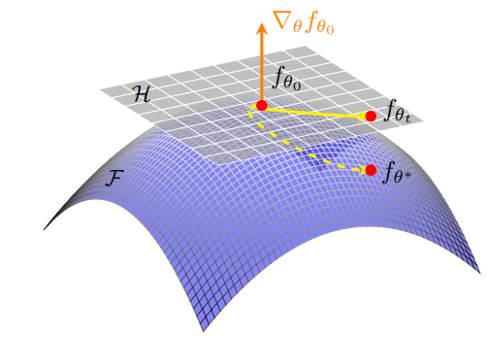



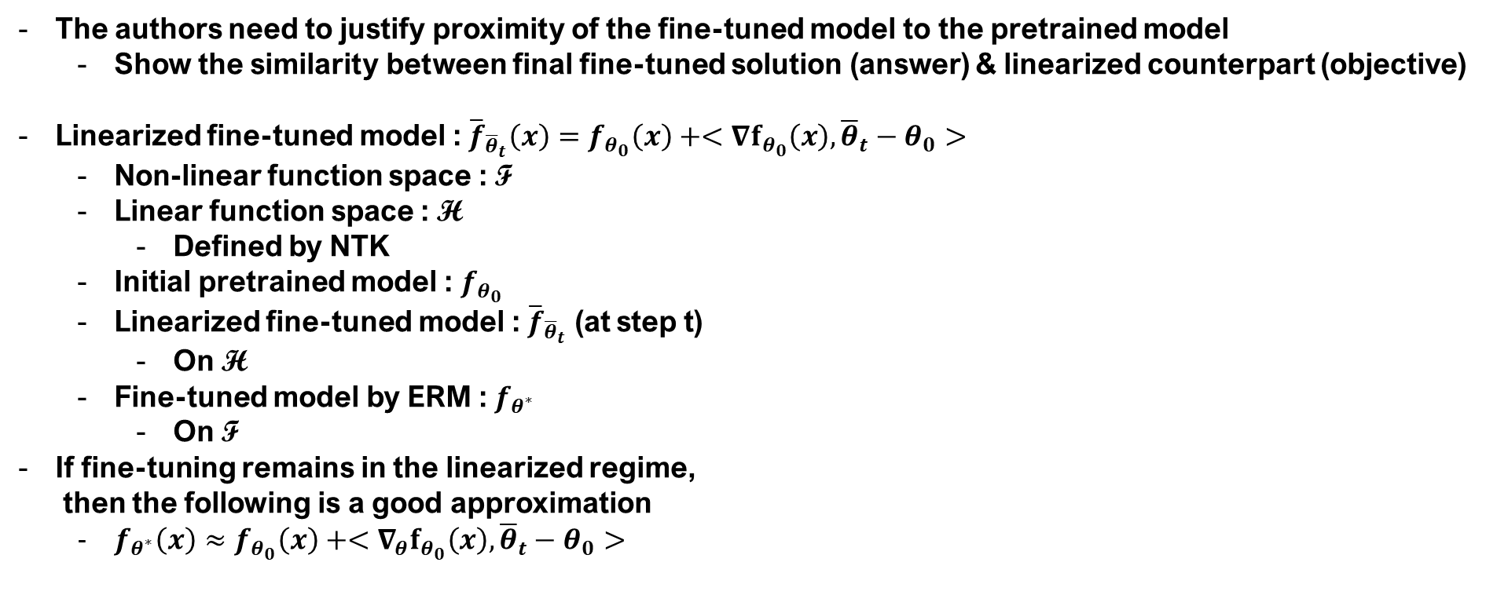
Proximity to the Pretrained Model Promotes Linearity
The authors need to justify proximity of the fine-tuned model to the pretrained model
  Show the similarity between final fine-tuned solution (answer) & linearized counterpart (objective)
Linearized fine-tuned model : ${\overline{f}}_{{\overline{θ}}_{t}}\left(x\right)=f_{θ_{0}}\left(x\right)+<∇f_{θ_{0}}\left(x\right),{\overline{θ}}_{t}−θ_{0}>$
  Non-linear function space : F
  Linear function space : H
    Defined by NTK
  Initial pretrained model : $f_{θ_{0}}$
  Linearized fine-tuned model : ${\overline{f}}_{{\overline{θ}}_{t}}$ (at step t)
    On H
  Fine-tuned model by ERM : $f_{θ^{∗}}$
    On F
If fine-tuning remains in the linearized regime,
then the following is a good approximation
  $f_{θ^{∗}}\left(x\right)≈f_{θ_{0}}\left(x\right)+<∇_{θ}f_{θ_{0}}\left(x\right),{\overline{θ}}_{t}−θ_{0}>$
$$f_{θ_{0}}$$
$${\overline{f}}_{\overline{θ}}$$
$$f_{θ^{∗}}$$
Afzal, Zahra Rahimi, et al. "Linearization Explains Fine-Tuning in Large Language Models." The 39th Annual Conference on NeurIPS.
Notes:
Fine-tuned model is regularized

Slide 9


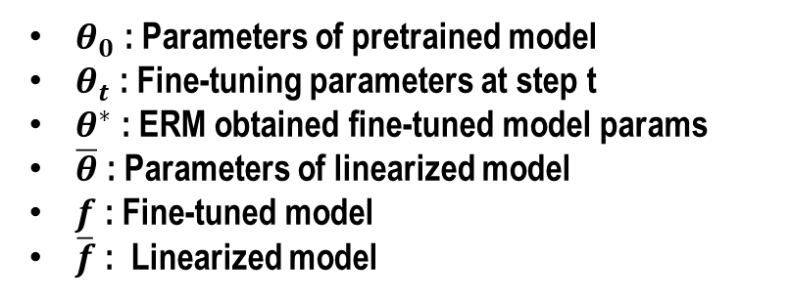

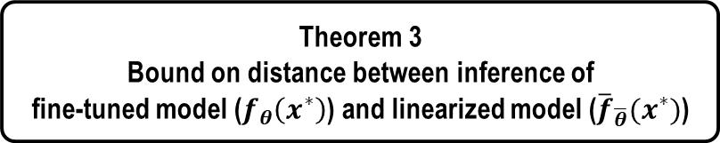

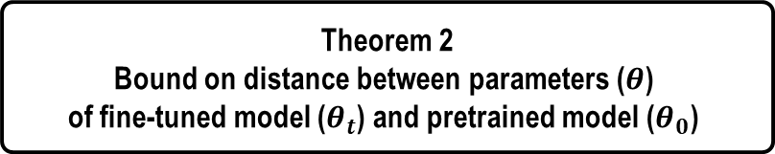

Proximity : Additional Slide
Linear
function space
pre-trained
model
linear-approximated
fine-tuned model
$$f_{θ_{0}}$$
$${\overline{f}}_{{\overline{θ}}_{t}}$$
$${\overline{f}}_{\overline{θ}}$$
Objective :
Justify that these are close
Non-linear
function space
$$f_{θ_{t}}$$
$$f_{θ^{∗}}$$
ERM regularized
fine-tuned model
Theorem 1
Monoticity of updates in
regularized fine-tuning
Theorem 2
Bound on distance between parameters ($θ$)
of fine-tuned model ($θ_{t}$) and pretrained model ($θ_{0}$)
$θ_{0}$ : Parameters of pretrained model
$θ_{t}$ : Fine-tuning parameters at step t
$θ^{∗}$ : ERM obtained fine-tuned model params
$\overline{θ}$ : Parameters of linearized model
$f$ : Fine-tuned model
$\overline{f}$ : Linearized model
Theorem 3
Bound on distance between inference of
fine-tuned model ($f_{θ}\left(x^{∗}\right)$) and linearized model (${\overline{f}}_{\overline{θ}}(x^{∗})$)
Afzal, Zahra Rahimi, et al. "Linearization Explains Fine-Tuning in Large Language Models." The 39th Annual Conference on NeurIPS.

Slide 10
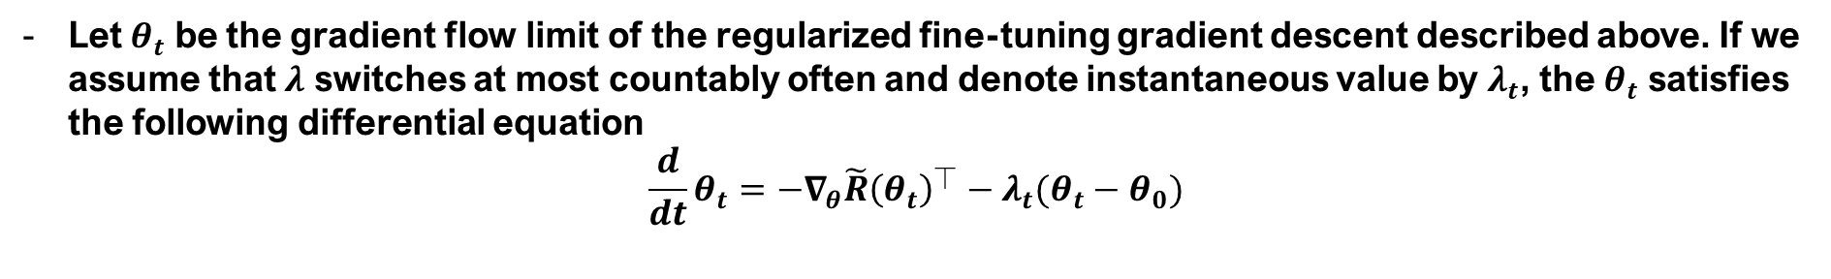
Lemma 3. Gradient Flow
Let $θ_{t}$ be the gradient flow limit of the regularized fine-tuning gradient descent described above. If we assume that $λ$ switches at most countably often and denote instantaneous value by $λ_{t}$, the $θ_{t}$ satisfies the following differential equation
$$\frac{d}{dt}θ_{t}=−∇_{θ}\tilde{R}{\left(θ_{t}\right)}^{⏉}−λ_{t}(θ_{t}−θ_{0})$$
Afzal, Zahra Rahimi, et al. "Linearization Explains Fine-Tuning in Large Language Models." The 39th Annual Conference on NeurIPS.

Slide 11
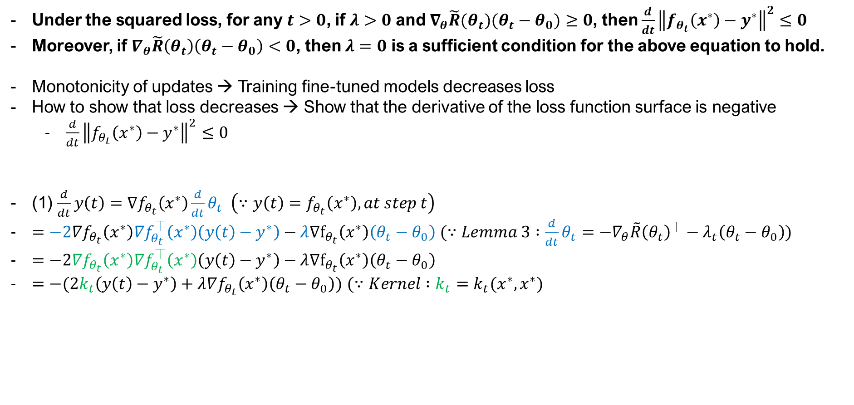

Theorem 1. Monotonic Updates in Regularized Fine-tuning
Under the squared loss, for any $t>0$, if $λ>0$ and $∇_{θ}\tilde{R}(θ_{t})(θ_{t}−θ_{0})≥0$, then $\frac{d}{dt}{\left\|f_{θ_{t}}\left(x^{∗}\right)−y^{∗}\right\|}^{2}≤0$
Moreover, if $∇_{θ}\tilde{R}\left(θ_{t}\right)\left(θ_{t}−θ_{0}\right)<0$, then $λ=0$ is a sufficient condition for the above equation to hold.
Monotonicity of updates → Training fine-tuned models decreases loss
How to show that loss decreases → Show that the derivative of the loss function surface is negative
  $\frac{d}{dt}{\left\|f_{θ_{t}}\left(x^{∗}\right)−y^{∗}\right\|}^{2}≤0$
(1) $\frac{d}{dt}y\left(t\right)=∇f_{θ_{t}}\left(x^{∗}\right)\frac{d}{dt}θ_{t} \left(∵y\left(t\right)=f_{θ_{t}}\left(x^{∗}\right), at step t\right)$
$=−2∇f_{θ_{t}}\left(x^{∗}\right)∇f_{θ_{t}}^{⏉}\left(x^{∗}\right)\left(y\left(t\right)−y^{∗}\right)−λ∇f_{θ_{t}}\left(x^{∗}\right)\left(θ_{t}−θ_{0}\right) (∵Lemma 3 :\frac{d}{dt}θ_{t}=−∇_{θ}\tilde{R}{\left(θ_{t}\right)}^{⏉}−λ_{t}\left(θ_{t}−θ_{0}\right))$
$=−2∇f_{θ_{t}}\left(x^{∗}\right)∇f_{θ_{t}}^{⏉}\left(x^{∗}\right)\left(y\left(t\right)−y^{∗}\right)−λ∇f_{θ_{t}}\left(x^{∗}\right)\left(θ_{t}−θ_{0}\right)$
$=−(2k_{t}\left(y\left(t\right)−y^{∗}\right)+λ∇f_{θ_{t}}\left(x^{∗}\right)\left(θ_{t}−θ_{0}\right))$ $(∵Kernel :k_{t}=k_{t}(x^{∗},x^{∗})$
MSE Loss $\tilde{R}\left(θ\right)$
Afzal, Zahra Rahimi, et al. "Linearization Explains Fine-Tuning in Large Language Models." The 39th Annual Conference on NeurIPS.

Slide 12
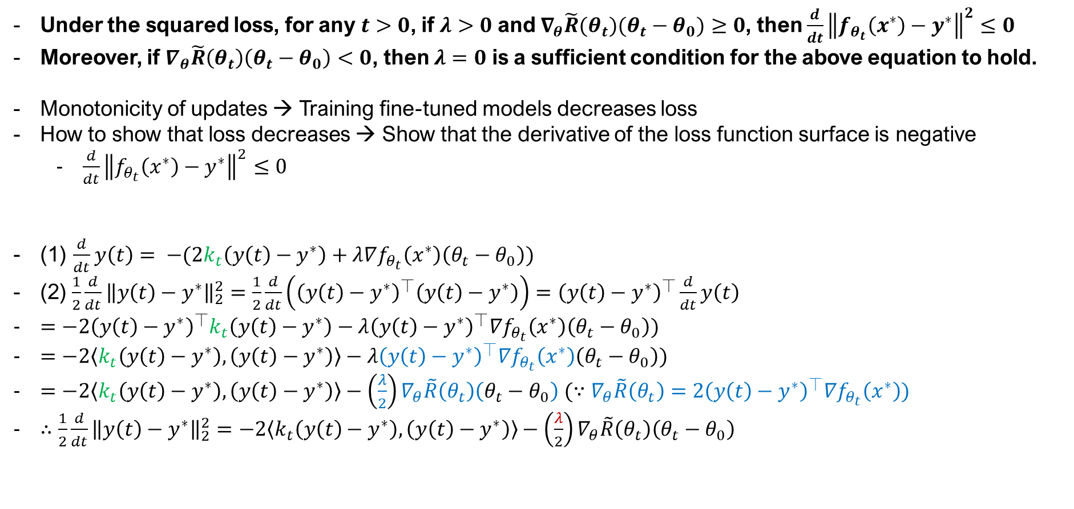
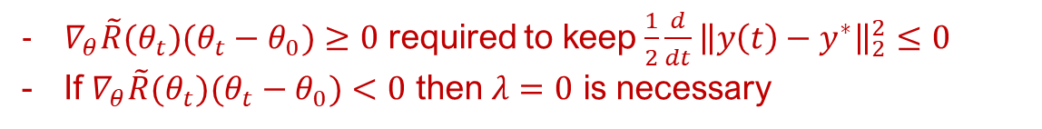


Theorem 1. Monotonic Updates in Regularized Fine-tuning
Under the squared loss, for any $t>0$, if $λ>0$ and $∇_{θ}\tilde{R}(θ_{t})(θ_{t}−θ_{0})≥0$, then $\frac{d}{dt}{\left\|f_{θ_{t}}\left(x^{∗}\right)−y^{∗}\right\|}^{2}≤0$
Moreover, if $∇_{θ}\tilde{R}\left(θ_{t}\right)\left(θ_{t}−θ_{0}\right)<0$, then $λ=0$ is a sufficient condition for the above equation to hold.
Monotonicity of updates → Training fine-tuned models decreases loss
How to show that loss decreases → Show that the derivative of the loss function surface is negative
  $\frac{d}{dt}{\left\|f_{θ_{t}}\left(x^{∗}\right)−y^{∗}\right\|}^{2}≤0$
(1) $\frac{d}{dt}y\left(t\right)= −(2k_{t}\left(y\left(t\right)−y^{∗}\right)+λ∇f_{θ_{t}}\left(x^{∗}\right)\left(θ_{t}−θ_{0}\right))$
(2) $\frac{1}{2}\frac{d}{dt}{\left\|y\left(t\right)−y^{∗}\right\|}_{2}^{2}=\frac{1}{2}\frac{d}{dt}\left({\left(y\left(t\right)−y^{∗}\right)}^{⏉}\left(y\left(t\right)−y^{∗}\right)\right)={\left(y\left(t\right)−y^{∗}\right)}^{⏉}\frac{d}{dt}y\left(t\right)$
$=−2{\left(y\left(t\right)−y^{∗}\right)}^{⏉}k_{t}\left(y\left(t\right)−y^{∗}\right)−λ{\left(y\left(t\right)−y^{∗}\right)}^{⏉}∇f_{θ_{t}}\left(x^{∗}\right)\left(θ_{t}−θ_{0}\right))$
$=−2\left\langle k_{t}\left(y\left(t\right)−y^{∗}\right),\left(y\left(t\right)−y^{∗}\right)\right\rangle −λ{\left(y\left(t\right)−y^{∗}\right)}^{⏉}∇f_{θ_{t}}\left(x^{∗}\right)\left(θ_{t}−θ_{0}\right))$
$=−2\left\langle k_{t}\left(y\left(t\right)−y^{∗}\right),\left(y\left(t\right)−y^{∗}\right)\right\rangle −\left(\frac{λ}{2}\right)∇_{θ}\tilde{R}\left(θ_{t}\right)\left(θ_{t}−θ_{0}\right) (∵∇_{θ}\tilde{R}\left(θ_{t}\right)=2{\left(y\left(t\right)−y^{∗}\right)}^{⏉}∇f_{θ_{t}}\left(x^{∗}\right))$
$∴\frac{1}{2}\frac{d}{dt}{\left\|y\left(t\right)−y^{∗}\right\|}_{2}^{2}=−2\left\langle k_{t}\left(y\left(t\right)−y^{∗}\right),\left(y\left(t\right)−y^{∗}\right)\right\rangle −\left(\frac{λ}{2}\right)∇_{θ}\tilde{R}\left(θ_{t}\right)\left(θ_{t}−θ_{0}\right)$
MSE Loss $\tilde{R}\left(θ\right)$
$≥0 (∵k_{t}=∇f_{θ_{t}}\left(x^{∗}\right)∇f_{θ_{t}}^{⏉}\left(x^{∗}\right)$ is semidefinite)
$∇_{θ}\tilde{R}(θ_{t})(θ_{t}−θ_{0})≥0$ required to keep $\frac{1}{2}\frac{d}{dt}{\left\|y\left(t\right)−y^{∗}\right\|}_{2}^{2}≤0$
If $∇_{θ}\tilde{R}(θ_{t})(θ_{t}−θ_{0})<0$ then $λ=0$ is necessary
Afzal, Zahra Rahimi, et al. "Linearization Explains Fine-Tuning in Large Language Models." The 39th Annual Conference on NeurIPS.

Slide 13

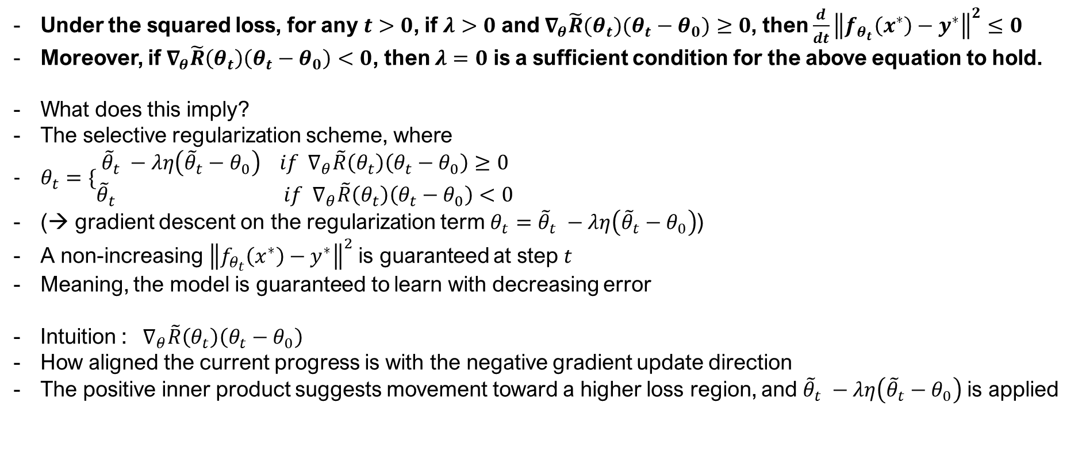
Theorem 1. Monotonic Updates in Regularized Fine-tuning
Under the squared loss, for any $t>0$, if $λ>0$ and $∇_{θ}\tilde{R}(θ_{t})(θ_{t}−θ_{0})≥0$, then $\frac{d}{dt}{\left\|f_{θ_{t}}\left(x^{∗}\right)−y^{∗}\right\|}^{2}≤0$
Moreover, if $∇_{θ}\tilde{R}\left(θ_{t}\right)\left(θ_{t}−θ_{0}\right)<0$, then $λ=0$ is a sufficient condition for the above equation to hold.
What does this imply?
The selective regularization scheme, where
$θ_{t}=\{\begin{matrix}{\tilde{θ}}_{t} −λη\left({\tilde{θ}}_{t}−θ_{0}\right) if ∇_{θ}\tilde{R}\left(θ_{t}\right)\left(θ_{t}−θ_{0}\right)≥0 \\ {\tilde{θ}}_{t} if{ ∇}_{θ}\tilde{R}\left(θ_{t}\right)\left(θ_{t}−θ_{0}\right)<0\end{matrix}$
(→ gradient descent on the regularization term $θ_{t}={\tilde{θ}}_{t} −λη\left({\tilde{θ}}_{t}−θ_{0}\right)$)
A non-increasing ${\left\|f_{θ_{t}}\left(x^{∗}\right)−y^{∗}\right\|}^{2}$ is guaranteed at step $t$
Meaning, the model is guaranteed to learn with decreasing error
Intuition : ${ ∇}_{θ}\tilde{R}\left(θ_{t}\right)\left(θ_{t}−θ_{0}\right)$
How aligned the current progress is with the negative gradient update direction
The positive inner product suggests movement toward a higher loss region, and ${\tilde{θ}}_{t} −λη\left({\tilde{θ}}_{t}−θ_{0}\right)$is applied
Afzal, Zahra Rahimi, et al. "Linearization Explains Fine-Tuning in Large Language Models." The 39th Annual Conference on NeurIPS.

Slide 14
Lemma 1. Norm Bounds and Lipschitzness
If for all $θ$ in a given range, $f_{θ}\left(x^{∗}\right)$ is $Lip\left(f\right)−Lipschitz$ in $θ$, and ${∇f}_{θ}\left(x^{∗}\right)$ is $Lip\left(∇f\right)−Lipschitz$ in $θ$, then $k_{θ}\left(x^{∗},x^{∗}\right)={∇f}_{θ}\left(x^{∗}\right){∇f}_{θ}{\left(x^{∗}\right)}^{⏉}∈ℝ^{n×n}$ is $Lip\left(k\right)−Lipschitz$ in $θ$, with
$Lip\left(k\right)≤2Lip\left(f\right)$ $Lip\left(∇f\right)$
Afzal, Zahra Rahimi, et al. "Linearization Explains Fine-Tuning in Large Language Models." The 39th Annual Conference on NeurIPS.

Slide 15
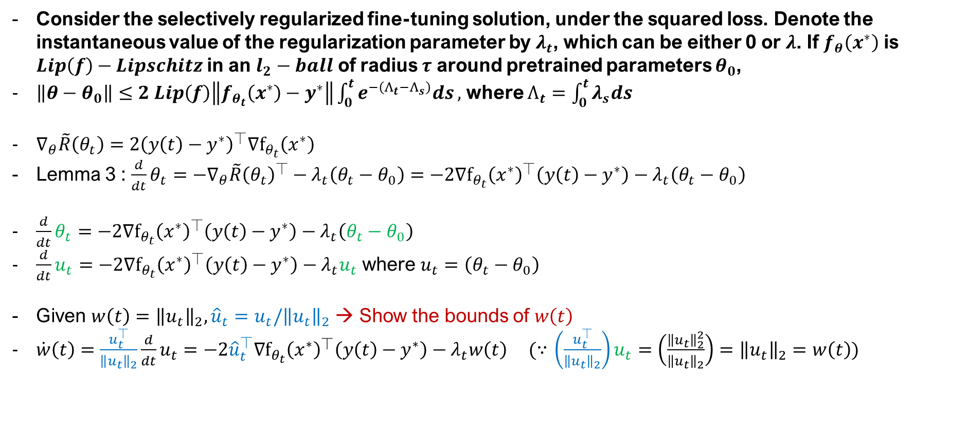
Theorem 2. UB on Distance between Parameters
Consider the selectively regularized fine-tuning solution, under the squared loss. Denote the instantaneous value of the regularization parameter by $λ_{t}$, which can be either 0 or $λ$. If $f_{θ}\left(x^{∗}\right)$ is $Lip\left(f\right)−Lipschitz$ in an $l_{2}−ball$ of radius $τ$ around pretrained parameters $θ_{0}$,
$\left\|θ−θ_{0}\right\|≤2 Lip\left(f\right)\left\|f_{θ_{t}}\left(x^{∗}\right)−y^{∗}\right\|\int_{0}^{t}{e^{−\left(Λ_{t}−Λ_{s}\right)}ds},$ where $Λ_{t}=\int_{0}^{t}{λ_{s}ds}$
$∇_{θ}\tilde{R}\left(θ_{t}\right)=2{\left(y\left(t\right)−y^{∗}\right)}^{⏉}∇f_{θ_{t}}\left(x^{∗}\right)$
Lemma 3 : $\frac{d}{dt}θ_{t}=−∇_{θ}\tilde{R}{\left(θ_{t}\right)}^{⏉}−λ_{t}\left(θ_{t}−θ_{0}\right)=−2∇f_{θ_{t}}{\left(x^{∗}\right)}^{⏉}\left(y\left(t\right)−y^{∗}\right)−λ_{t}\left(θ_{t}−θ_{0}\right)$
$\frac{d}{dt}θ_{t}=−2∇f_{θ_{t}}{\left(x^{∗}\right)}^{⏉}\left(y\left(t\right)−y^{∗}\right)−λ_{t}\left(θ_{t}−θ_{0}\right)$
$\frac{d}{dt}u_{t}=−2∇f_{θ_{t}}{\left(x^{∗}\right)}^{⏉}\left(y\left(t\right)−y^{∗}\right)−λ_{t}u_{t}$ where $u_{t}=\left(θ_{t}−θ_{0}\right)$
Given $w\left(t\right)={\left\|u_{t}\right\|}_{2},{\hat{u}}_{t}=u_{t}/{\left\|u_{t}\right\|}_{2}$ → Show the bounds of $w\left(t\right)$
$\dot{w}\left(t\right)=\frac{u_{t}^{⏉}}{{\left\|u_{t}\right\|}_{2}}\frac{d}{dt}u_{t}=−2{\hat{u}}_{t}^{⏉}∇f_{θ_{t}}{\left(x^{∗}\right)}^{⏉}\left(y\left(t\right)−y^{∗}\right)−λ_{t}w\left(t\right) (∵$ $\left(\frac{u_{t}^{⏉}}{{\left\|u_{t}\right\|}_{2}}\right)u_{t}=\left(\frac{{\left\|u_{t}\right\|}_{2}^{2}}{{\left\|u_{t}\right\|}_{2}}\right)={\left\|u_{t}\right\|}_{2}=w\left(t\right))$
Afzal, Zahra Rahimi, et al. "Linearization Explains Fine-Tuning in Large Language Models." The 39th Annual Conference on NeurIPS.

Slide 16

Theorem 2. UB on Distance between Parameters
Consider the selectively regularized fine-tuning solution, under the squared loss. Denote the instantaneous value of the regularization parameter by $λ_{t}$, which can be either 0 or $λ$. If $f_{θ}\left(x^{∗}\right)$ is $Lip\left(f\right)−Lipschitz$ in an $l_{2}−ball$ of radius $τ$ around pretrained parameters $θ_{0}$,
$\left\|θ−θ_{0}\right\|≤2 Lip\left(f\right)\left\|f_{θ_{t}}\left(x^{∗}\right)−y^{∗}\right\|\int_{0}^{t}{e^{−\left(Λ_{t}−Λ_{s}\right)}ds},$ where $Λ_{t}=\int_{0}^{t}{λ_{s}ds}$
$\dot{w}\left(t\right)=−2{\hat{u}}_{t}^{⏉}∇f_{θ_{t}}{\left(x^{∗}\right)}^{⏉}\left(y\left(t\right)−y^{∗}\right)−λ_{t}w\left(t\right)$
$−{\hat{u}}_{t}^{⏉}∇f_{θ_{t}}{\left(x^{∗}\right)}^{⏉}\left(y\left(t\right)−y^{∗}\right)≤\left\|f_{θ_{t}}\left(x^{∗}\right)\right\|{\left\|y\left(t\right)−y^{∗}\right\|}_{2} ≤Lip(f){\left\|y\left(t\right)−y^{∗}\right\|}_{2}$
$∴−2{\hat{u}}_{t}^{⏉}∇f_{θ_{t}}{\left(x^{∗}\right)}^{⏉}\left(y\left(t\right)−y^{∗}\right)≤2Lip(f){\left\|y\left(t\right)−y^{∗}\right\|}_{2}$
Hence, $\dot{w}\left(t\right)≤−λ_{t}w\left(t\right)+2 Lip\left(f\right){\left\|y\left(t\right)−y^{∗}\right\|}_{2}→\dot{w}\left(t\right)+λ_{t}w\left(t\right)≤2 Lip\left(f\right){\left\|y\left(t\right)−y^{∗}\right\|}_{2}$
$(∵\left\|f_{θ_{t}}\left(x^{∗}\right)\right\|≤Lip\left(f\right))$ → Lemma 1
Afzal, Zahra Rahimi, et al. "Linearization Explains Fine-Tuning in Large Language Models." The 39th Annual Conference on NeurIPS.

Slide 17

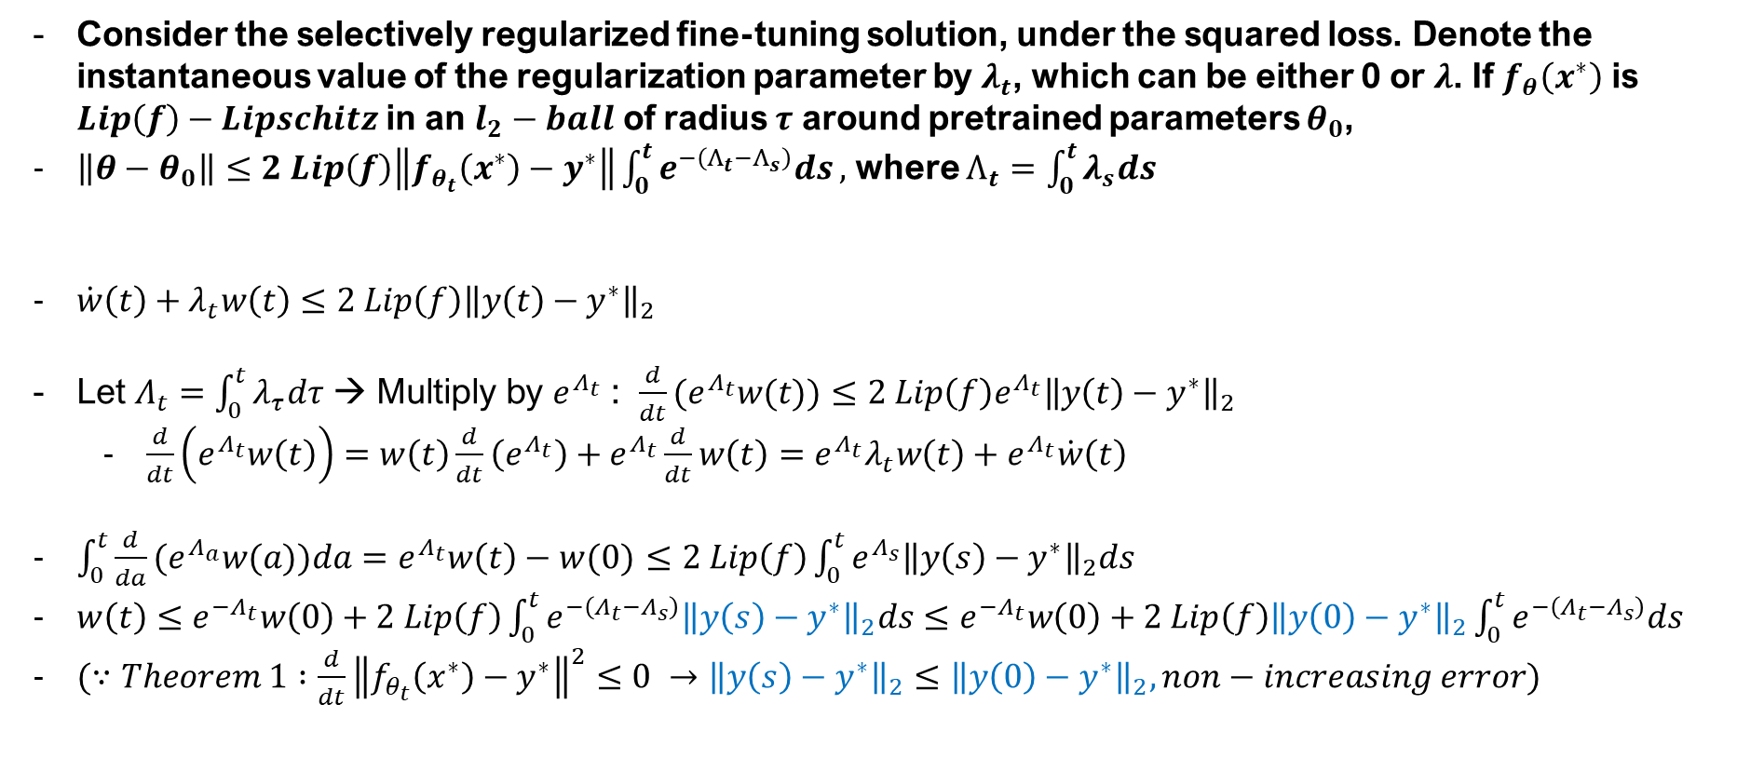
Theorem 2. UB on Distance between Parameters
Consider the selectively regularized fine-tuning solution, under the squared loss. Denote the instantaneous value of the regularization parameter by $λ_{t}$, which can be either 0 or $λ$. If $f_{θ}\left(x^{∗}\right)$ is $Lip\left(f\right)−Lipschitz$ in an $l_{2}−ball$ of radius $τ$ around pretrained parameters $θ_{0}$,
$\left\|θ−θ_{0}\right\|≤2 Lip\left(f\right)\left\|f_{θ_{t}}\left(x^{∗}\right)−y^{∗}\right\|\int_{0}^{t}{e^{−\left(Λ_{t}−Λ_{s}\right)}ds},$ where $Λ_{t}=\int_{0}^{t}{λ_{s}ds}$
$\dot{w}\left(t\right)+λ_{t}w\left(t\right)≤2 Lip\left(f\right){\left\|y\left(t\right)−y^{∗}\right\|}_{2}$
Let $Λ_{t}=\int_{0}^{t}{λ_{τ}dτ}$ → Multiply by $e^{Λ_{t}}$ : $\frac{d}{dt}(e^{Λ_{t}}w(t))≤2 Lip\left(f\right)e^{Λ_{t}}{\left\|y\left(t\right)−y^{∗}\right\|}_{2}$
  $\frac{d}{dt}\left(e^{Λ_{t}}w\left(t\right)\right)=w\left(t\right)\frac{d}{dt}\left(e^{Λ_{t}}\right)+e^{Λ_{t}}\frac{d}{dt}w\left(t\right)=e^{Λ_{t}}λ_{t}w\left(t\right)+e^{Λ_{t}}\dot{w}\left(t\right)$
$\int_{0}^{t}{\frac{d}{da}(e^{Λ_{a}}w(a))da}=e^{Λ_{t}}w\left(t\right)−w(0)$ $≤2 Lip\left(f\right)\int_{0}^{t}{e^{Λ_{s}}{\left\|y\left(s\right)−y^{∗}\right\|}_{2}ds}$
$w\left(t\right)≤e^{{−Λ}_{t}}w\left(0\right)+2 Lip\left(f\right)\int_{0}^{t}{e^{−\left({Λ_{t}−Λ}_{s}\right)}{\left\|y\left(s\right)−y^{∗}\right\|}_{2}ds}≤e^{{−Λ}_{t}}w\left(0\right)+2 Lip\left(f\right){\left\|y\left(0\right)−y^{∗}\right\|}_{2}\int_{0}^{t}{e^{−\left({Λ_{t}−Λ}_{s}\right)}ds}$
$(∵Theorem 1 :\frac{d}{dt}{\left\|f_{θ_{t}}\left(x^{∗}\right)−y^{∗}\right\|}^{2}≤0 →{\left\|y\left(s\right)−y^{∗}\right\|}_{2}≤{\left\|y\left(0\right)−y^{∗}\right\|}_{2}, non−increasing error)$
Afzal, Zahra Rahimi, et al. "Linearization Explains Fine-Tuning in Large Language Models." The 39th Annual Conference on NeurIPS.

Slide 18
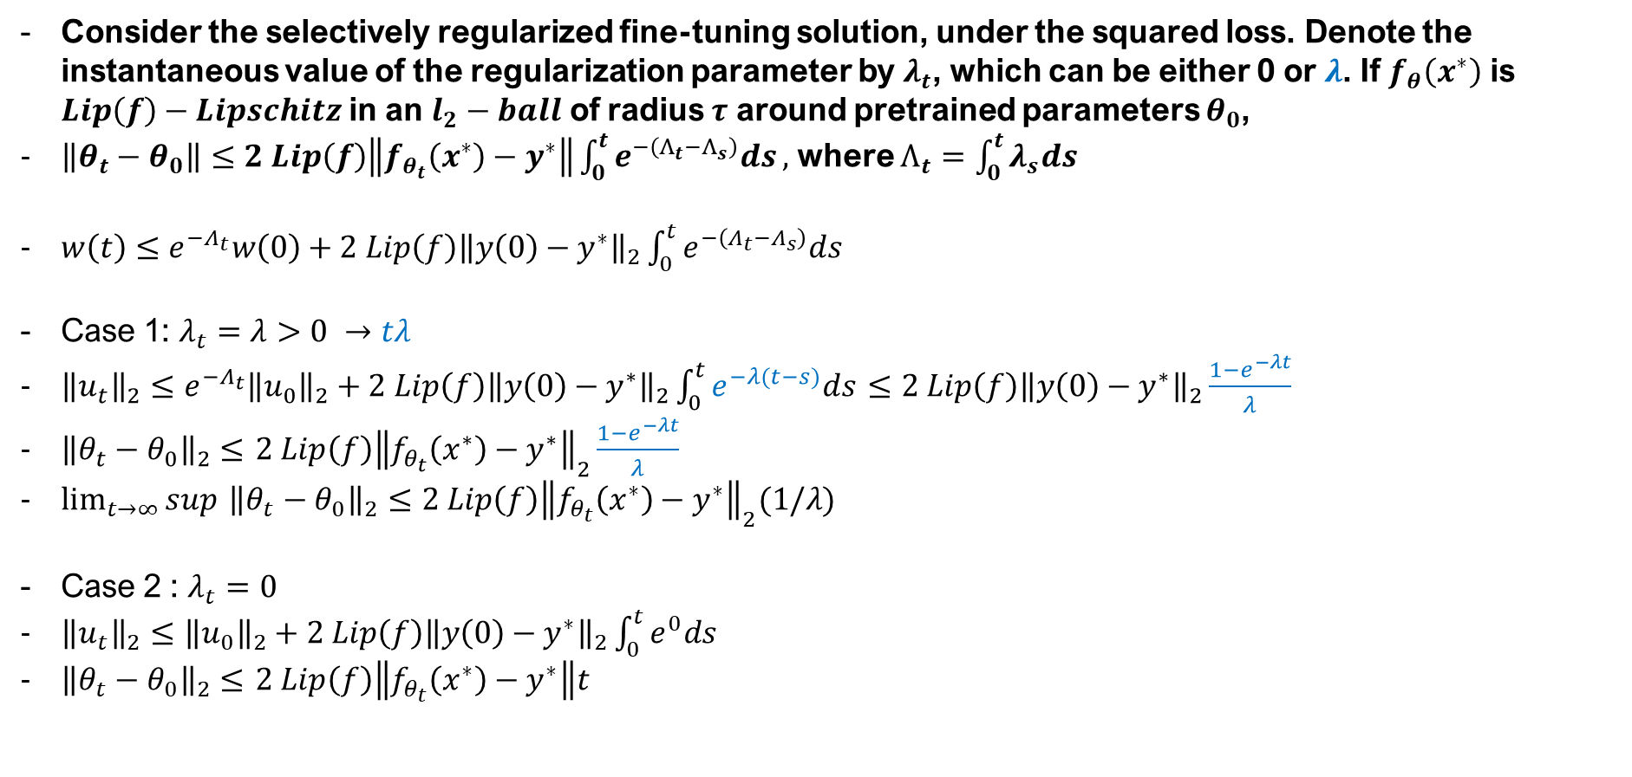
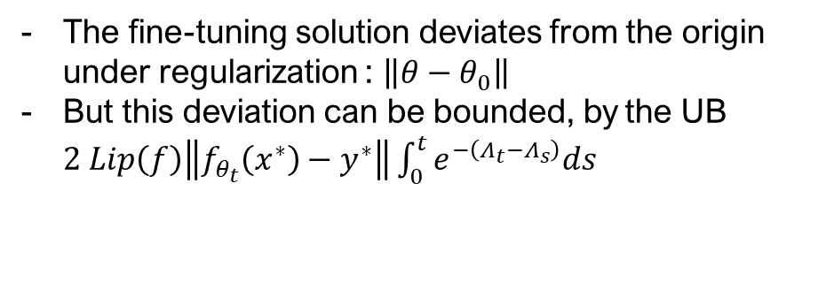
Theorem 2. UB on Distance between Parameters
Consider the selectively regularized fine-tuning solution, under the squared loss. Denote the instantaneous value of the regularization parameter by $λ_{t}$, which can be either 0 or $λ$. If $f_{θ}\left(x^{∗}\right)$ is $Lip\left(f\right)−Lipschitz$ in an $l_{2}−ball$ of radius $τ$ around pretrained parameters $θ_{0}$,
$\left\|θ_{t}−θ_{0}\right\|≤2 Lip\left(f\right)\left\|f_{θ_{t}}\left(x^{∗}\right)−y^{∗}\right\|\int_{0}^{t}{e^{−\left(Λ_{t}−Λ_{s}\right)}ds},$ where $Λ_{t}=\int_{0}^{t}{λ_{s}ds}$
$w\left(t\right)≤e^{{−Λ}_{t}}w\left(0\right)+2 Lip\left(f\right){\left\|y\left(0\right)−y^{∗}\right\|}_{2}\int_{0}^{t}{e^{−\left({Λ_{t}−Λ}_{s}\right)}ds}$
Case 1: $λ_{t}=λ>0 →tλ$
${\left\|u_{t}\right\|}_{2}≤e^{{−Λ}_{t}}{\left\|u_{0}\right\|}_{2}+2 Lip\left(f\right){\left\|y\left(0\right)−y^{∗}\right\|}_{2}\int_{0}^{t}{e^{−λ(t−s)}ds}$ $≤2 Lip\left(f\right){\left\|y\left(0\right)−y^{∗}\right\|}_{2}\frac{1−e^{−λt}}{λ}$
${\left\|θ_{t}−θ_{0}\right\|}_{2}≤$ $2 Lip\left(f\right){\left\|f_{θ_{t}}\left(x^{∗}\right)−y^{∗}\right\|}_{2}\frac{1−e^{−λt}}{λ}$
$\lim_{t→∞}{sup}$ ${\left\|θ_{t}−θ_{0}\right\|}_{2}≤$ $2 Lip\left(f\right){\left\|f_{θ_{t}}\left(x^{∗}\right)−y^{∗}\right\|}_{2}(1/λ)$
Case 2 : $λ_{t}=0$
${\left\|u_{t}\right\|}_{2}≤{\left\|u_{0}\right\|}_{2}+2 Lip\left(f\right){\left\|y\left(0\right)−y^{∗}\right\|}_{2}\int_{0}^{t}{e^{0}ds}$
${\left\|θ_{t}−θ_{0}\right\|}_{2}≤$ $2 Lip\left(f\right)\left\|f_{θ_{t}}\left(x^{∗}\right)−y^{∗}\right\|t$
The fine-tuning solution deviates from the origin under regularization : $\left\|θ−θ_{0}\right\|$
But this deviation can be bounded, by the UB $2 Lip\left(f\right)\left\|f_{θ_{t}}\left(x^{∗}\right)−y^{∗}\right\|\int_{0}^{t}{e^{−\left(Λ_{t}−Λ_{s}\right)}ds}$
Afzal, Zahra Rahimi, et al. "Linearization Explains Fine-Tuning in Large Language Models." The 39th Annual Conference on NeurIPS.

Slide 19
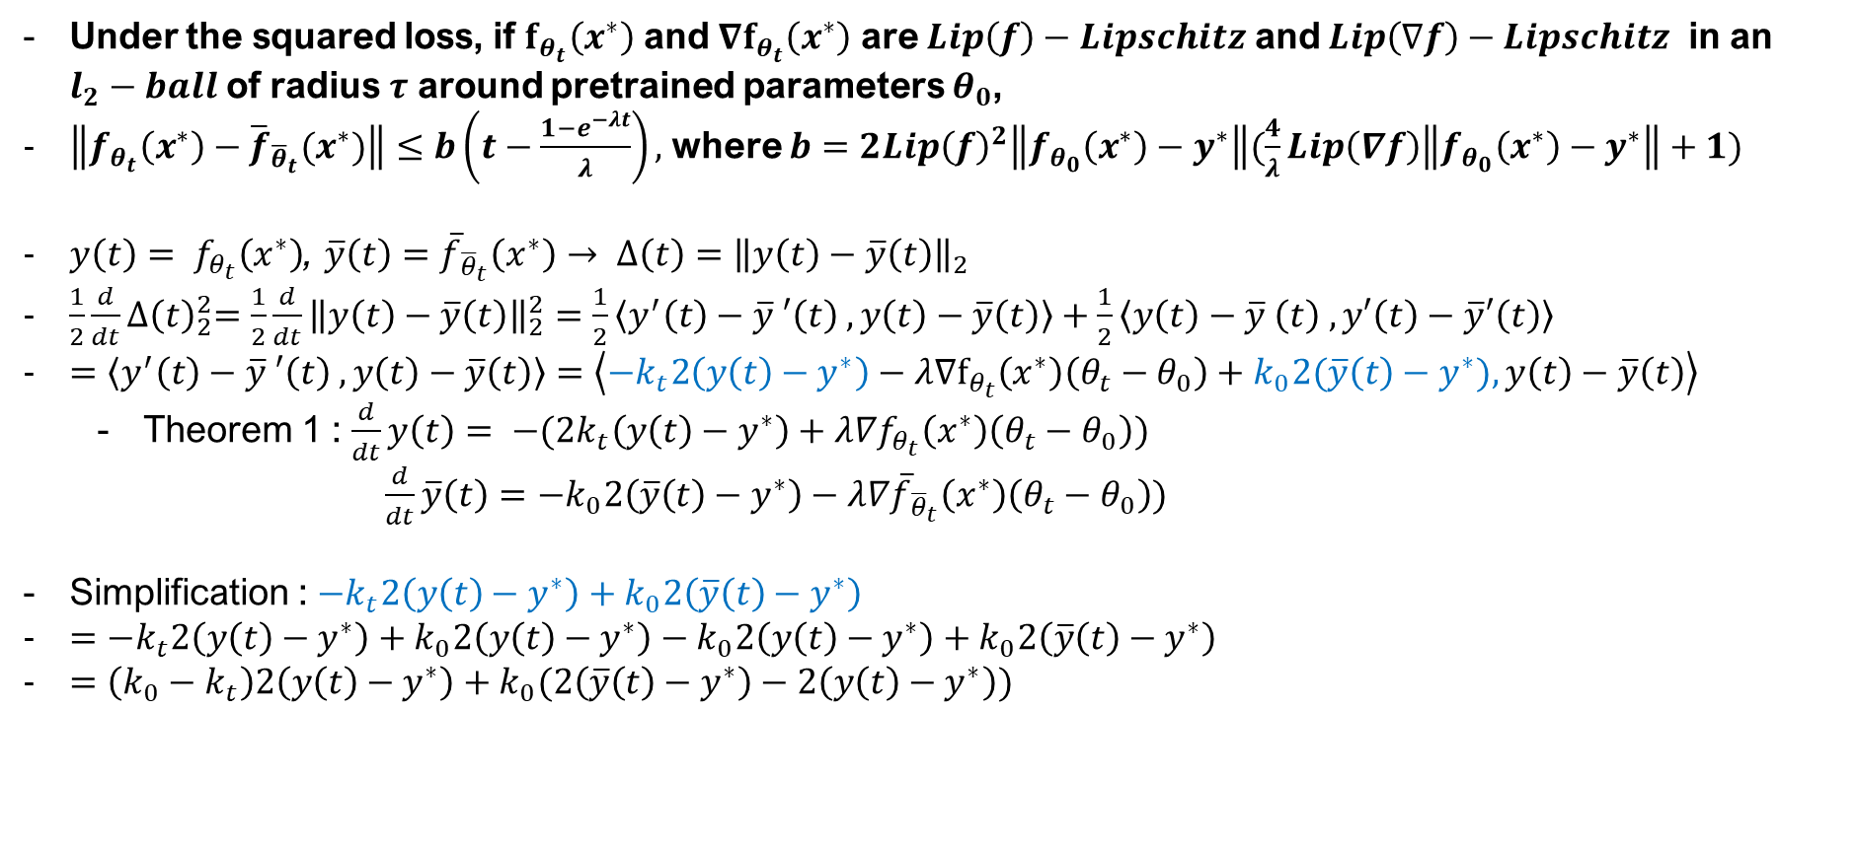
Theorem 3. UB on Distance between Parameters
Under the squared loss, if $f_{θ_{t}}\left(x^{∗}\right)$ and $∇f_{θ_{t}}\left(x^{∗}\right)$ are $Lip\left(f\right)−Lipschitz$ and $Lip\left(∇f\right)−Lipschitz$ in an $l_{2}−ball$ of radius $τ$ around pretrained parameters $θ_{0}$,
$\left\|f_{θ_{t}}\left(x^{∗}\right)−{\overline{f}}_{{\overline{θ}}_{t}}(x^{∗})\right\|≤b\left(t−\frac{1−e^{−λt}}{λ}\right),$where $b=2Lip{\left(f\right)}^{2}\left\|f_{θ_{0}}\left(x^{∗}\right)−y^{∗}\right\|(\frac{4}{λ}Lip\left(∇f\right)\left\|f_{θ_{0}}\left(x^{∗}\right)−y^{∗}\right\|+1)$
$y\left(t\right)= f_{θ_{t}}\left(x^{∗}\right)$, $\overline{y}\left(t\right)={\overline{f}}_{{\overline{θ}}_{t}}\left(x^{∗}\right)→ ∆\left(t\right)={\left\|y\left(t\right)−\overline{y}\left(t\right)\right\|}_{2}$
$\frac{1}{2}\frac{d}{dt}{∆\left(t\right)}_{2}^{2}=\frac{1}{2}\frac{d}{dt}{\left\|y\left(t\right)−\overline{y}\left(t\right)\right\|}_{2}^{2}=\frac{1}{2}\left\langle y^{′}\left(t\right)−\overline{y} ′\left(t\right) ,y\left(t\right)−\overline{y}\left(t\right)\right\rangle +\frac{1}{2}\left\langle y\left(t\right)−\overline{y} \left(t\right) ,y′\left(t\right)−\overline{y}′\left(t\right)\right\rangle$
$=\left\langle y^{′}\left(t\right)−\overline{y} ′\left(t\right) ,y\left(t\right)−\overline{y}\left(t\right)\right\rangle =\left\langle −k_{t}2\left(y\left(t\right)−y^{∗}\right)−λ∇f_{θ_{t}}\left(x^{∗}\right)\left(θ_{t}−θ_{0}\right)+k_{0}2(\overline{y}\left(t\right)−y^{∗}),y\left(t\right)−\overline{y}\left(t\right)\right\rangle$
  Theorem 1 : $\frac{d}{dt}y\left(t\right)= −(2k_{t}\left(y\left(t\right)−y^{∗}\right)+λ∇f_{θ_{t}}\left(x^{∗}\right)\left(θ_{t}−θ_{0}\right))$
  $\frac{d}{dt}\overline{y}\left(t\right)=−k_{0}2\left(\overline{y}\left(t\right)−y^{∗}\right)−λ∇{\overline{f}}_{{\overline{θ}}_{t}}\left(x^{∗}\right)\left(θ_{t}−θ_{0}\right))$
Simplification : $−k_{t}2\left(y\left(t\right)−y^{∗}\right)+k_{0}2\left(\overline{y}\left(t\right)−y^{∗}\right)$
$=−k_{t}2\left(y\left(t\right)−y^{∗}\right)+k_{0}2\left(y\left(t\right)−y^{∗}\right)−k_{0}2\left(y\left(t\right)−y^{∗}\right)+k_{0}2\left(\overline{y}\left(t\right)−y^{∗}\right)$
$=\left(k_{0}−k_{t}\right)2\left(y\left(t\right)−y^{∗}\right)+k_{0}(2\left(\overline{y}\left(t\right)−y^{∗}\right)−2\left(y\left(t\right)−y^{∗}\right))$
Afzal, Zahra Rahimi, et al. "Linearization Explains Fine-Tuning in Large Language Models." The 39th Annual Conference on NeurIPS.

Slide 20

Theorem 3. UB on Distance between Parameters
Under the squared loss, if $f_{θ_{t}}\left(x^{∗}\right)$ and $∇f_{θ_{t}}\left(x^{∗}\right)$ are $Lip\left(f\right)−Lipschitz$ and $Lip\left(∇f\right)−Lipschitz$ in an $l_{2}−ball$ of radius $τ$ around pretrained parameters $θ_{0}$,
$\left\|f_{θ_{t}}\left(x^{∗}\right)−{\overline{f}}_{{\overline{θ}}_{t}}(x^{∗})\right\|≤b\left(t−\frac{1−e^{−λt}}{λ}\right),$where $b=2Lip{\left(f\right)}^{2}\left\|f_{θ_{0}}\left(x^{∗}\right)−y^{∗}\right\|(\frac{4}{λ}Lip\left(∇f\right)\left\|f_{θ_{0}}\left(x^{∗}\right)−y^{∗}\right\|+1)$
$\frac{1}{2}\frac{d}{dt}{∆\left(t\right)}_{2}^{2}=\left\langle −k_{t}2\left(y\left(t\right)−y^{∗}\right)−λ∇f_{θ_{t}}\left(x^{∗}\right)\left(θ_{t}−θ_{0}\right)+k_{0}2(\overline{y}\left(t\right)−y^{∗}),y\left(t\right)−\overline{y}\left(t\right)\right\rangle$
$−k_{t}2\left(y\left(t\right)−y^{∗}\right)+k_{0}2\left(\overline{y}\left(t\right)−y^{∗}\right)=\left(k_{0}−k_{t}\right)2\left(y\left(t\right)−y^{∗}\right)+k_{0}(2\left(\overline{y}\left(t\right)−y^{∗}\right)−2\left(y\left(t\right)−y^{∗}\right))$
Substitution : $\frac{1}{2}\frac{d}{dt}{∆\left(t\right)}_{2}^{2}=$ $\left\langle \left(k_{0}−k_{t}\right)2\left(y\left(t\right)−y^{∗}\right)−λ∇f_{θ_{t}}\left(x^{∗}\right)\left(θ_{t}−θ_{0}\right),y\left(t\right)−\overline{y}\left(t\right)\right\rangle +\left\langle k_{0}(2\left(\overline{y}\left(t\right)−y^{∗}\right)−2\left(y\left(t\right)−y^{∗}\right)),y\left(t\right)−\overline{y}\left(t\right)\right\rangle$
  $\left\langle k_{0}(2\left(\overline{y}\left(t\right)−y^{∗}\right)−2\left(y\left(t\right)−y^{∗}\right)),y\left(t\right)−\overline{y}\left(t\right)\right\rangle =−2{\left(y\left(t\right)−\overline{y}\left(t\right)\right)}^{⏉}k_{0}(y\left(t\right)−\overline{y}\left(t\right))≤0$
  $(∵∇f_{θ_{0}}{\left(x^{∗}\right)}^{⏉}$ $∇f_{θ_{0}}{\left(x^{∗}\right)}^{⏉}$ is positive semidefinite)
$∴\frac{1}{2}\frac{d}{dt}{∆\left(t\right)}_{2}^{2}≤\left\langle \left(k_{0}−k_{t}\right)2\left(y\left(t\right)−y^{∗}\right)−λ∇f_{θ_{t}}\left(x^{∗}\right)\left(θ_{t}−θ_{0}\right),y\left(t\right)−\overline{y}\left(t\right)\right\rangle$
Afzal, Zahra Rahimi, et al. "Linearization Explains Fine-Tuning in Large Language Models." The 39th Annual Conference on NeurIPS.

Slide 21

Theorem 3. UB on Distance between Parameters
Under the squared loss, if $f_{θ_{t}}\left(x^{∗}\right)$ and $∇f_{θ_{t}}\left(x^{∗}\right)$ are $Lip\left(f\right)−Lipschitz$ and $Lip\left(∇f\right)−Lipschitz$ in an $l_{2}−ball$ of radius $τ$ around pretrained parameters $θ_{0}$,
$\left\|f_{θ_{t}}\left(x^{∗}\right)−{\overline{f}}_{{\overline{θ}}_{t}}(x^{∗})\right\|≤b\left(t−\frac{1−e^{−λt}}{λ}\right),$where $b=2Lip{\left(f\right)}^{2}\left\|f_{θ_{0}}\left(x^{∗}\right)−y^{∗}\right\|(\frac{4}{λ}Lip\left(∇f\right)\left\|f_{θ_{0}}\left(x^{∗}\right)−y^{∗}\right\|+1)$
$\frac{d}{dt}∆\left(t\right)=‖\left(k_{0}−k_{t}\right)2\left(y\left(t\right)−y^{∗}\right)−λ∇f_{θ_{t}}\left(x^{∗}\right)\left(θ_{t}−θ_{0}\right),y\left(t\right)−\overline{y}\left(t\right)‖$
$≤\left\|\left(k_{0}−k_{t}\right)2\left(y\left(t\right)−y^{∗}\right)\right\|−λ\left\|∇f_{θ_{t}}\left(x^{∗}\right)\left(θ_{t}−θ_{0}\right),y\left(t\right)−\overline{y}\left(t\right)\right\| ∵Triangular inequality)$
$≤‖\left(k_{0}−k_{t}\right)2\left(y\left(t\right)−y^{∗}\right)‖−λ‖∇f_{θ_{t}}\left(x^{∗}\right)\left(θ_{t}−θ_{0}\right),y\left(t\right)−\overline{y}\left(t\right)‖$
$≤Lip\left(k\right)\left\|\left(θ_{t}−θ_{0}\right)\right\|\left\|2\left(y\left(t\right)−y^{∗}\right)\right\|+λLip(f){‖θ}_{t}−θ_{0}‖ (∵k_{θ}\left(x^{∗},x^{∗}\right) \text{is} Lip\left(k\right)−Lipschitz)$
$≤2Lip\left(k\right)\left\|\left(θ_{t}−θ_{0}\right)\right\|\left\|\left(y\left(0\right)−y^{∗}\right)\right\|+λLip(f){‖θ}_{t}−θ_{0}‖$
$≤4Lip\left(k\right)Lip\left(f\right){\left\|\left(y\left(0\right)−y^{∗}\right)\right\|}^{2}\frac{\left(1−e^{−λt}\right)}{λ}+2Lip^{2}\left(f\right)\left\|y\left(0\right)−y^{∗}\right\|\left(1−e^{−λt}\right) (∵Theorem 2)$
$≤−2Lip\left(f\right)\left\|\left(y\left(0\right)−y^{∗}\right)\right\|\left(\frac{2}{λ}Lip\left(k\right)\left\|y\left(0\right)−y^{∗}\right\|+Lip\left(f\right)\right)\left(e^{−λt}\right)$
$+2Lip(f)\left\|\left(y\left(0\right)−y^{∗}\right)\right\|\left(\frac{2}{λ}Lip\left(k\right)\left\|y\left(0\right)−y^{∗}\right\|+Lip\left(f\right)\right)$
Afzal, Zahra Rahimi, et al. "Linearization Explains Fine-Tuning in Large Language Models." The 39th Annual Conference on NeurIPS.

Slide 22
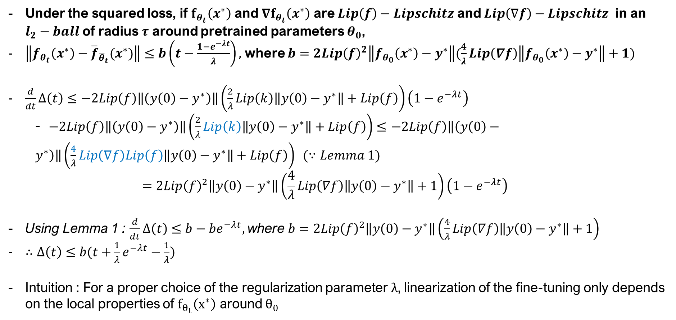
Theorem 3. UB on Distance between Parameters
Under the squared loss, if $f_{θ_{t}}\left(x^{∗}\right)$ and $∇f_{θ_{t}}\left(x^{∗}\right)$ are $Lip\left(f\right)−Lipschitz$ and $Lip\left(∇f\right)−Lipschitz$ in an $l_{2}−ball$ of radius $τ$ around pretrained parameters $θ_{0}$,
$\left\|f_{θ_{t}}\left(x^{∗}\right)−{\overline{f}}_{{\overline{θ}}_{t}}(x^{∗})\right\|≤b\left(t−\frac{1−e^{−λt}}{λ}\right),$where $b=2Lip{\left(f\right)}^{2}\left\|f_{θ_{0}}\left(x^{∗}\right)−y^{∗}\right\|(\frac{4}{λ}Lip\left(∇f\right)\left\|f_{θ_{0}}\left(x^{∗}\right)−y^{∗}\right\|+1)$
$\frac{d}{dt}∆\left(t\right)≤−2Lip\left(f\right)\left\|\left(y\left(0\right)−y^{∗}\right)\right\|\left(\frac{2}{λ}Lip\left(k\right)\left\|y\left(0\right)−y^{∗}\right\|+Lip\left(f\right)\right)\left(1−e^{−λt}\right)$
  - $−2Lip\left(f\right)\left\|\left(y\left(0\right)−y^{∗}\right)\right\|\left(\frac{2}{λ}Lip\left(k\right)\left\|y\left(0\right)−y^{∗}\right\|+Lip\left(f\right)\right)≤$ $−2Lip\left(f\right)\left\|\left(y\left(0\right)−y^{∗}\right)\right\|\left(\frac{4}{λ}Lip\left(∇f\right)Lip\left(f\right)\left\|y\left(0\right)−y^{∗}\right\|+Lip\left(f\right)\right) (∵Lemma 1)$
  $$=2Lip{\left(f\right)}^{2}\left\|y\left(0\right)−y^{∗}\right\|\left(\frac{4}{λ}Lip\left(∇f\right)\left\|y\left(0\right)−y^{∗}\right\|+1\right)\left(1−e^{−λt}\right)$$
Using Lemma 1 : $\frac{d}{dt}∆\left(t\right)≤b−be^{−λt},$where $b=2Lip{\left(f\right)}^{2}\left\|y\left(0\right)−y^{∗}\right\|\left(\frac{4}{λ}Lip\left(∇f\right)\left\|y\left(0\right)−y^{∗}\right\|+1\right)$
$∴∆\left(t\right)≤b(t+\frac{1}{λ}e^{−λt}−\frac{1}{λ})$
Intuition : For a proper choice of the regularization parameter $λ$, linearization of the fine-tuning only depends on the local properties of $f_{θ_{t}}\left(x^{∗}\right)$ around $θ_{0}$
Afzal, Zahra Rahimi, et al. "Linearization Explains Fine-Tuning in Large Language Models." The 39th Annual Conference on NeurIPS.

Slide 23

Theorem 4.
Under the squared loss, if $f_{θ_{t}}\left(x^{∗}\right)$ and $∇f_{θ_{t}}\left(x^{∗}\right)$ are $Lip\left(f\right)−Lipschitz$ and $Lip\left(∇f\right)−Lipschitz$ in an $l_{2}−ball$ of radius $r$ around pretrained parameters $θ_{0}.$
Define $λ_{∘}=\frac{2\left\|f_{θ_{0}}\left(x^{∗}\right)−y^{∗}\right\|Lip(f)}{r}$
If $λ≥λ_{∘}$, then for all $t$, the following holds
If $λ<λ_{∘}$, then the following holds for $t≤\frac{1}{λ}ln(\frac{1}{1−λ/λ_{∘}})$
In particular, for $λ≥λ_{∘}$, the bound from theorem 3 always holds and simplifies to
$\left\|f_{θ_{t}}\left(x^{∗}\right)−{\overline{f}}_{{\overline{θ}}_{t}}(x^{∗})\right\|≤2Lip\left(f\right)\tilde{R}\left(θ_{0}\right)\left(2rLip\left(∇f\right)+Lip\left(f\right)\right)t$
The bound “$2Lip\left(f\right)\tilde{R}\left(θ_{0}\right)\left(2rLip\left(∇f\right)+Lip\left(f\right)\right)t$”
  Holds when $λ$ is large → But it also implies that $r$ needs to be small, where the parameters need to be close to the pretrained parameters
  If $λ$ is small, the bound holds when the time step is smaller than a certain value
The authors provide with a guide to deciding an appropriate regularization parameter $λ_{∘}$
However, certain inquiries arise with respect to the bounding value
Afzal, Zahra Rahimi, et al. "Linearization Explains Fine-Tuning in Large Language Models." The 39th Annual Conference on NeurIPS.

Slide 24
Section 4 : Fine-Tuning Meets NTK Regression
EECE695D : Deep Learning Theory

Slide 25
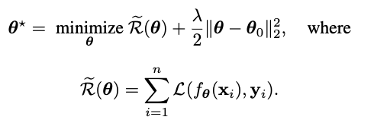
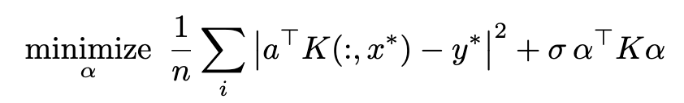
Fine-tuning can be defined as RKHS
As so far, we showed that regularized fine-tuning is in the linearized regime.
Linearized regime? NTK!
Regularized fine-tuning → Kernel ridge regression problem
Afzal, Zahra Rahimi, et al. "Linearization Explains Fine-Tuning in Large Language Models." The 39th Annual Conference on NeurIPS.
Notes:
지금까지 저희는 pretrained weight 주변으로 강한 L2 regularization을 걸어주게 되면 fine-tuning이 first-order taylor expansion으로 잘 approximation이 될 수 있음을 보였습니다,
그래서 결국 이는 linearized model을 훈련하는 것과 같습니다.
모델이 gradient feature에 대해서 linear하게 되면, 우리는 이를 NTK의 관점으로 바라볼 수 있게 됩니다.
뒤에서 다시 설명하겠지만, Neural Tangent Kernel은 이 feature들의 inner product로 정의되고, fine-tuning 문제는 정확히 kernel ridge regression 문제가 되고, 곧 다음과 같은 objective를 푸는 것으로 바뀔 수 있습니다.
어떻게 왼쪽의 objective가 오른쪽과 같이 바뀔 수 있는 지 다음 슬라이드에서부터 설명하겠습니다.

Slide 26
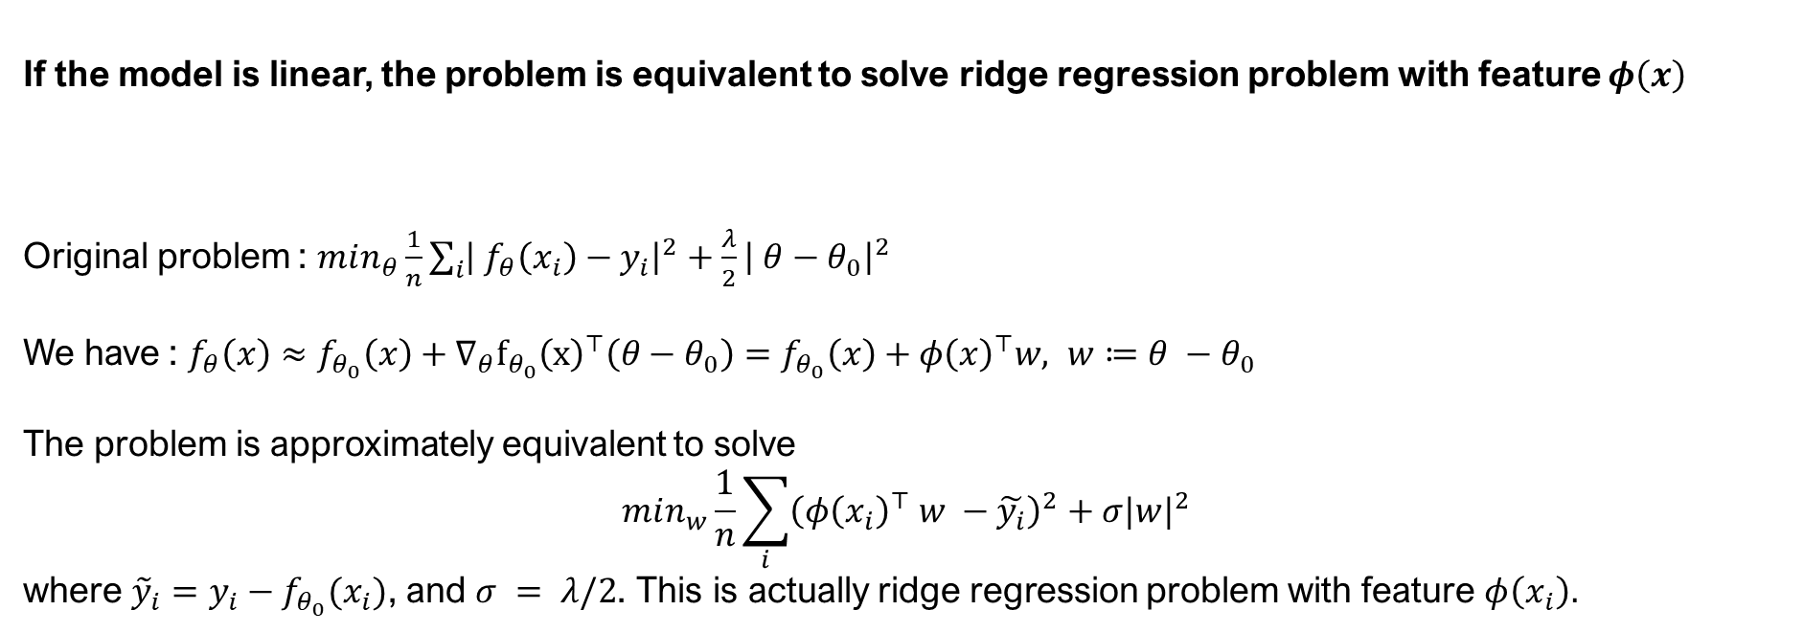
Fine-tuning can be defined as RKHS
As so far, we showed that regularized fine-tuning is in the linearized regime.
Linearized regime? NTK!
If the model is linear, the problem is equivalent to solve ridge regression problem with feature $φ\left(x\right)$
Original problem : $min_{θ}\frac{1}{n}\sum_{i}{{\left| f_{θ}\left(x_{i}\right)−y_{i}\right|}^{2}+\frac{λ}{2}{\left| θ−θ_{0}\right|}^{2}}$
We have : $f_{θ}\left(x\right)≈f_{θ_{0}}\left(x\right)+∇_{θ}f_{θ_{0}}{\left(x\right)}^{⊤}\left(θ−θ_{0}\right)=f_{θ_{0}}\left(x\right)+φ{\left(x\right)}^{⊤}w, w≔θ −θ_{0}$
The problem is approximately equivalent to solve
$$min_{w}\frac{1}{n}\sum_{i}{{\left(φ{\left(x_{i}\right)}^{⊤} w −\tilde{y_{i}}\right)}^{2}+σ|w|^{2}}$$
where ${\tilde{y}}_{i}=y_{i}−f_{θ_{0}}(x_{i})$, and $σ = λ/2$. This is actually ridge regression problem with feature $φ\left(x_{i}\right).$
Afzal, Zahra Rahimi, et al. "Linearization Explains Fine-Tuning in Large Language Models." The 39th Annual Conference on NeurIPS.
Notes:
이제 원래 문제로부터 시작해서 왜 앞에서 보았던 kernel ridge regression 문제로 바꿀 수 있는 지 보이겠습니다.
우선 이전에 저희가 정의했던 problem은 다음과 같습니다. MSE loss에서 L2 regularizer를 initial point에 걸어준 형태입니다.
이 형태가 linearized regime에 있을 수 있음을 이미 보였기 때문에, 다음과 같이 first-order taylor expansion을 사용하여 모델을 \theta_0 근처에서 approximate할 수 있습니다. 이제 feature vector phi (x)를 gradient로 정의하고, w를 \theta – initial point로 하겠습니다.
그럼 우리는 다음과 같이 식을 다시 쓸 수 있고, 이를 그대로 원래 문제에 넣어주게 되면 다음과 같은 형태를 얻을 수가 있습니다. 이때 y hat은 y_i – f_\theta_0(x_i)로 정의할 수 있습니다.
이제 이 문제는 feature vector phi에 대한 ridge regression problem입니다.

Slide 27
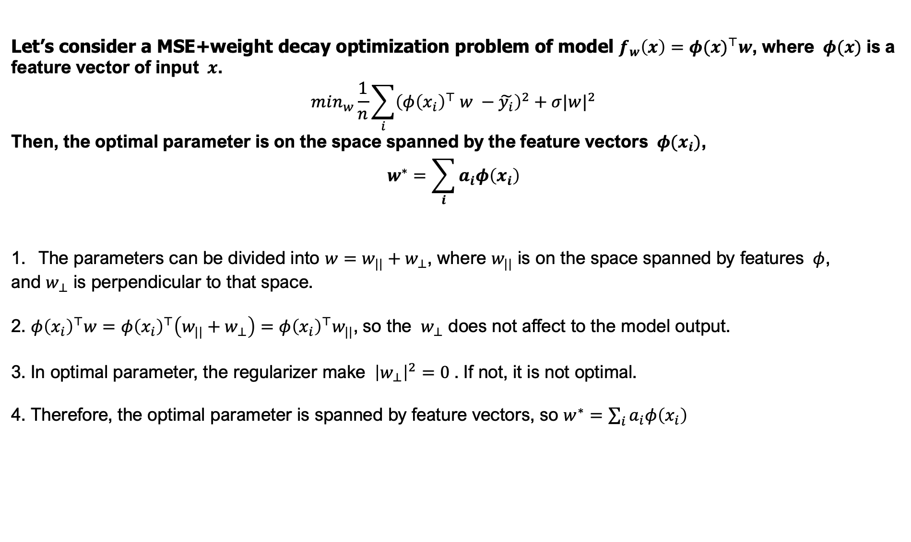
Optimal parameter of MSE + weight decay objective
Let’s consider a MSE+weight decay optimization problem of model $f_{w}\left(x\right)={φ(x)}^{⊤}w$, where $φ(x)$ is a feature vector of input $x$.
$$min_{w}\frac{1}{n}\sum_{i}{{\left(φ{\left(x_{i}\right)}^{⊤} w −\tilde{y_{i}}\right)}^{2}+σ|w|^{2}}$$
Then, the optimal parameter is on the space spanned by the feature vectors $φ(x_{i})$,
$$w^{∗}=\sum_{i}{a_{i}φ\left(x_{i}\right)}$$
The parameters can be divided into $w=w_{||}+w_{⊥}$, where $w_{||}$ is on the space spanned by features $φ$,
and $w_{⊥}$ is perpendicular to that space.
2. $φ{\left(x_{i}\right)}^{⊤}w=φ{\left(x_{i}\right)}^{⊤}\left(w_{||}+w_{⊥}\right)=φ{\left(x_{i}\right)}^{⊤}w_{||}$, so the $w_{⊥}$ does not affect to the model output.
3. In optimal parameter, the regularizer make ${\left|w_{⊥}\right|}^{2}=0$. If not, it is not optimal.
4. Therefore, the optimal parameter is spanned by feature vectors, so $w^{∗}=\sum_{i}{a_{i}φ\left(x_{i}\right)}$
Notes:
이 슬라이드에서는 우리가 만든 ridge regression problem에 대해서 좀 더 자세히 살펴볼 예정입니다.
이 슬라이드에서 주장하는 것은 ridge regression problem으로 구해진 최적의 파라미터 w*가 feature vector의 linear combination으로 나타내질 수 있다는 점입니다.
간단하게 이를 보일 수가 있는데, 우선 첫번째로 parameter vector w를 feature vector가 span하는 space 위에 있는 것과, 그것에 orthogonal한 part로 나눌 수가 있습니다.
그렇게 나눠보면, regularizer 외의 파트에서는 그 orthogonal part가 0으로 사라지기 때문에 영향을 끼치지 못한다는 것을 알 수가 있습니다. 그래서 training data의 model prediction에 어떠한 영향도 주지 못함을 알 수 있습니다.
그 다음으로 regularizer part를 보게 되면 orthogonal part가 0이 되어야 함을 알 수 있습니다. 그렇지 않은 경우에는 optimal 하지 않기 때문이죠.
결론적으로, optimal parameter w*는 feature vector에 의해서 span되는 space 위에 놓여있게 됩니다.

Slide 28
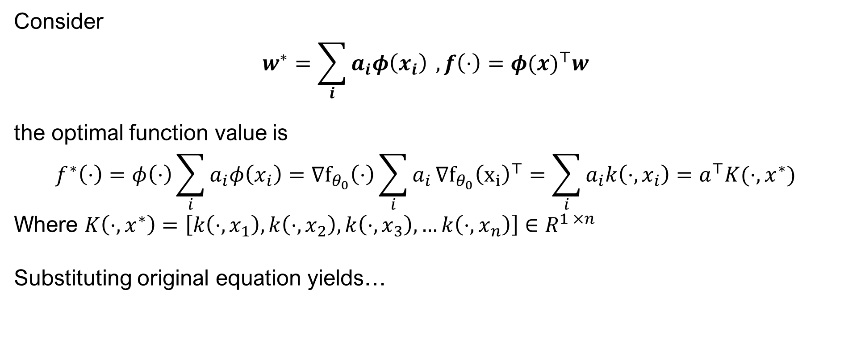
Fine-tuning can be defined as RKHS
Consider
$$w^{∗}=\sum_{i}{a_{i}φ\left(x_{i}\right)} , f\left(⋅\right)={φ(x)}^{⊤}w$$
the optimal function value is
$$f^{∗}\left(⋅\right)=φ\left(⋅\right)\sum_{i}{a_{i}φ\left(x_{i}\right)=∇f_{θ_{0}}\left(⋅\right)\sum_{i}{a_{i}}∇f_{θ_{0}}{\left(x_{i}\right)}^{⊤}}=\sum_{i}{a_{i}k\left(⋅, x_{i}\right)=a^{⊤}K(⋅, x^{∗})}$$
Where $K\left(⋅, x^{∗}\right)=\left[k\left(⋅, x_{1}\right), k\left(⋅, x_{2}\right), k\left(⋅, x_{3}\right), …k\left(⋅,x_{n}\right)\right]∈R^{1 ×n }$
Substituting original equation yields…
Afzal, Zahra Rahimi, et al. "Linearization Explains Fine-Tuning in Large Language Models." The 39th Annual Conference on NeurIPS.
Notes:
이제 optimal parameter가 어떤 형태인지 알고 있기 때문에, optimal 함수 또한 어떤 형태로 이루어졌는지 알 수 있습니다.
이전에 함수가 위와 같이 feature vector과 parameter w의 내적으로 이루어짐을 보였기 때문이죠.
그래서 이를 그대로 작성해보면 다음과 같이 feature들의 내적, 즉 kernel의 linear combination으로 나타낼 수 있습니다.
여기서 이 form을 matrix로 나타내고, K를 gram matrix라고 부르겠습니다. 이전에 original form을 위의 형태로 교체하면 우리가 optimize할 수 있는 것은 alpha가 되고, 아까전에 보았던 form을 그대로 가질 수 있게 됩니다.

Slide 29
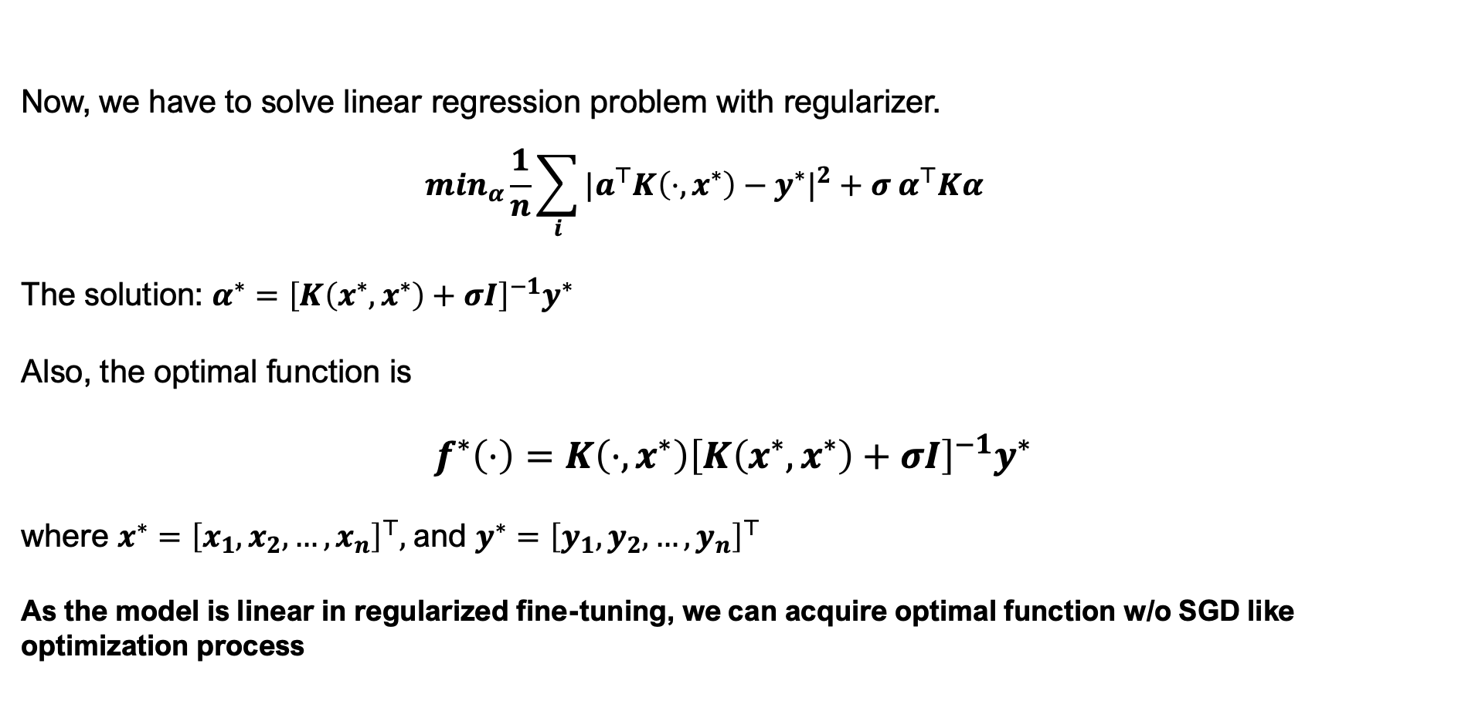
Fine-tuning can be defined as RKHS
Now, we have to solve linear regression problem with regularizer.
  $$min_{α}\frac{1}{n}\sum_{i}{|a^{⊤}K\left(⋅, x^{∗}\right)−y^{∗}|^{2}+σ α^{⊤}Kα}$$
The solution: $α^{∗}={\left[K\left(x^{∗}, x^{∗}\right)+σI\right]}^{−1}y^{∗}$
Also, the optimal function is
$$f^{∗}\left(⋅\right)=K\left(⋅, x^{∗}\right){\left[K\left(x^{∗}, x^{∗}\right)+σI\right]}^{−1}y^{∗}$$
where $x^{∗}={\left[x_{1}, x_{2}, …, x_{n}\right]}^{⊤},$and $y^{∗}={\left[y_{1}, y_{2}, …, y_{n}\right]}^{⊤}$
As the model is linear in regularized fine-tuning, we can acquire optimal function w/o SGD like optimization process
Afzal, Zahra Rahimi, et al. "Linearization Explains Fine-Tuning in Large Language Models." The 39th Annual Conference on NeurIPS.
Notes:
이제 앞에서 만든 새로운 objective를 풀어야합니다. 근데 이 형태는 우리가 analytic하게 풀 수 있는 형태입니다.
이 식 자체를 미분해서 0이 되는 \alpha를 찾음녀 다음과 같은 형태를 우리가 가질 수 있게 됩니다.
앞서 optimal 함수의 형태를 우리가 구했던 바가 있으므로, optimal alpha를 넣어주게 되면 다음과 같은 형태를 구할 수 있습니다.
이로써 만약 regularized fine-tuning 상에서 모델이 linear이므로, 우리가 optimal 함수를 SGD 스타일의 optimization process 없이도 얻을 수 있게 됩니다.

Slide 30

NTK directly affects the empirical risk
Theorem 5: The empirical risk is bounded as
$${\left(\frac{σ\left|y^{∗}\right|}{σ+λ_{max}\left(K\right)}\right)}^{2}≤R\left(θ\right)≤{\left(\frac{σ\left|y^{∗}\right|}{σ+λ_{min}\left(K\right)}\right)}^{2}$$
where $λ_{min}(K)$ and $λ_{max}(K)$ are the minimum and maximum eigenvalues of $K(x^{∗}, x^{∗})$, repectively.
The regularized condition number as at-initialization metric for predicting the performance of fine-tuning.
Let condition number as $κ\left(K+σI\right)=\frac{λ_{max}\left(K\right)+σ}{λ_{min}\left(K\right)+σ}$ . For given $λ_{max}\left(K\right)$, If $κ$ is small, the risk can be small, and the risk is high otherwise.
It can be useful in fine-tuning
  ex) selecting what subset of parameters to tune.
  We will show this later.
Afzal, Zahra Rahimi, et al. "Linearization Explains Fine-Tuning in Large Language Models." The 39th Annual Conference on NeurIPS.
Notes:
이번 슬라이드 부터는는 저자들이 linearization을 NTK로 나타낼 수 있다는 사실을 어떻게 활용했는 지를 살펴보겠습니다.
여기서는 NTK에서 사용되는 gram matrix K를 통해 어떻게 empirical risk를 bound할 수 있는지를 보여줍니다.
참고로 Gram matrix K는 xi, xj의 kernel function의 값을 i, j element의 값으로 가지는 matrix입니다.
우선 식의 형태를 먼저 살펴보겠습니다. 이 식을 보면 empirical risk가 gram matrix의 eigen value와 관련된 값으로 bound 될 수 있음을 살펴볼 수 있습니다.
오른쪽 inequality는 minimum eigenvalue와 관련되어 있고, 왼쪽 inequality는 maximum inequality와 관련되어 있으니, gram matrix의 condition number가 작을수록 empirical risk가 작을 것이라 기대할 수 있고, 클수록 risk가 높을 것이라 기대할 수 있습니다. 저자들은 이것이 어떤 parameter를 tune할 지 선택할 때에 유용할 수 있다고 주장합니다. 이는 뒤에서 좀 더 살펴보겠습니다.

Slide 31
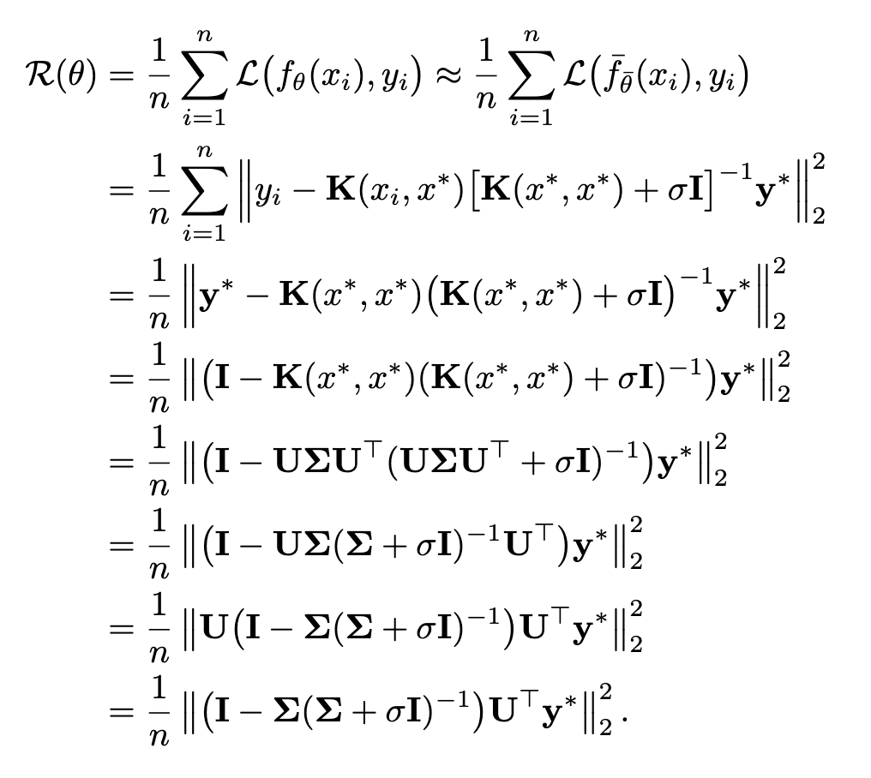
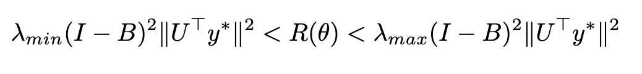
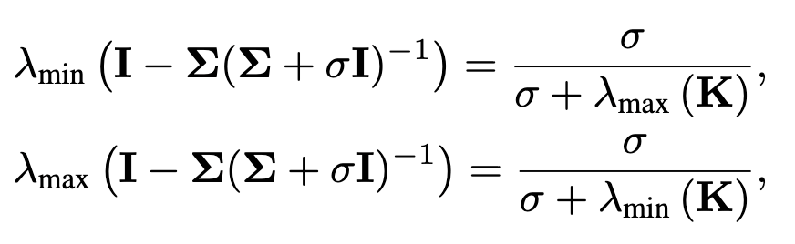
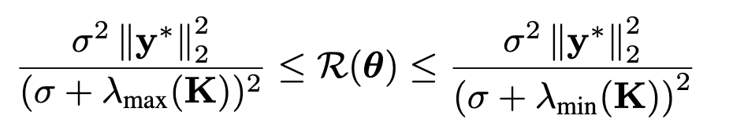

Proof of theorem 5
Let $UΣU^{⊤}$ denote the eigenvalue decomposition of K.
Since $B = Σ{\left(Σ+σI\right)}^{−1}$is diagonal matrix, we have
Also, Note that
Therefore,
Afzal, Zahra Rahimi, et al. "Linearization Explains Fine-Tuning in Large Language Models." The 39th Annual Conference on NeurIPS.
Notes:
이번 슬라이드에서는 theorem 5를 증명할 예정입니다. 증명은 굉장히 간단한데요,
우선 empirical risk를 다음과 같이 linearized function으로 approximate하고, 앞서 구한 optimal function으로 대체하여 씁니다. 그 뒤에는 그냥 vector form으로 변환한 식입니다.
그 다음에 y*를 뒤로 빼주고, K를 eigenvalue decomposition 하면 이런 식을 얻을수가 있고, 얘를 다시 U SIGMA로 묶어주면 다음과 같이 나타낼 수 있습니다.
이 식에서 U가 orthonormal matrix이므로 2-norm에서 U를 그냥 빼줄 수가 있습니다. 앞에서 이 복잡한 부분을 B로 나타내주고, B는 우리가 그냥 diagonal matrix임을 알 수 있습니다.
이제 empirical risk를 I-B의 eigenvalue를 기준으로 다음과 같이 bound를 할 수 있습니다.
또, B의 eigenvalue가 다음과 같이 계산되어질 수 있으니까, 또다시 orthonormal matrix의 성질을 사용하면 theorem에서의 형태를 얻을 수 있습니다.
그래서 저자들은 Gram matrix K의 eigenvalue를 보는 것이 empirical risk를 잘 bound시킬 수 있는 출발점이라 판단했습니다.

Slide 32
Section 5 : Spectral Perturbation of Layers
EECE695D : Deep Learning Theory
Notes:
이번 slide에서는 앞서 구한 theorem 5을 바탕으로 어떻게 layer selection 기준으로 이용했는지 살펴보겠습니다.

Slide 33
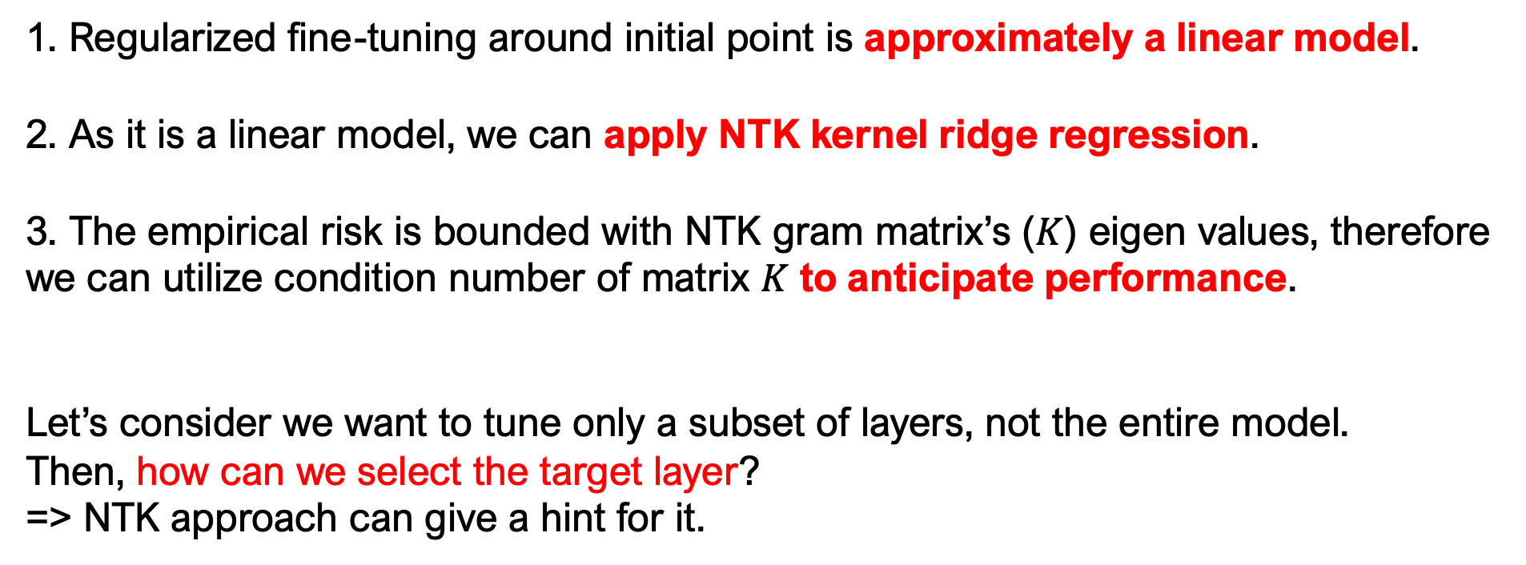
So far…
1. Regularized fine-tuning around initial point is approximately a linear model.
2. As it is a linear model, we can apply NTK kernel ridge regression.
3. The empirical risk is bounded with NTK gram matrix’s ($K$) eigen values, therefore we can utilize condition number of matrix $K$ to anticipate performance.
Let’s consider we want to tune only a subset of layers, not the entire model.
Then, how can we select the target layer?
=> NTK approach can give a hint for it.
Afzal, Zahra Rahimi, et al. "Linearization Explains Fine-Tuning in Large Language Models." The 39th Annual Conference on NeurIPS.
Notes:
지금까지 보인걸 정리해보면 첫 번째로 initial point 주변에서 크게 벗어나지 않도록 regularize한 fine-tuning은 approximately linear model임을 볼 수 있습니다.
두 번째로, linear model이므로 이 상황에서 NTK kernel ridge regression을 적용할 수 있음을 보였습니다.
마지막으로, empirical risk가 NTK gram matrix의 eigenvalue로 bound 될 수 있음을 보여서, matrix K의 condition number를 performance 예측의 지표로서 어느정도 활용할 수 있을 것이다라는 기반을 마련했습니다.
이제 저자들은 이를 활용할 수 있는 상황을 제시했는데요, PEFT 상황에서 어떤 layer를 tuning할 지 고르는 상황입니다.

Slide 34

NTK Eigenvalue Stability under Layer Addition
Theorem 6: Let $K$ be the NTK with respect to the set of selected fine-tuning parameters, and $S$ be the kernel with respect to the parameters of the candidate layers, to add to the fine-tuning parameters. Then,
$$\left(1−η\right)λ_{i}\left(K\right)≤λ_{i}\left(K+S\right)≤\left(1+η\right)λ_{i}\left(K\right)$$
where $η=|K^{−1/2}SK^{−1/2}|$, ${\left[S_{l}\right]}_{i,j}=∇_{θ_{l}}f_{θ}\left(x_{i}\right)∇_{θ_{l}}f_{θ}{\left(x_{j}\right)}^{⊤}$
Proof: skip
Each eigenvalue of K+S is bounded at most $[1 – η, 1+ η]$
We can get useful insight if we combine this with previous finding:
  If $η$ is small, we don’t have to select that layer, since it doesn’t affect empirical risk much.
  If $η$ is large enough and doesn’t mass up the condition number, it is worth to tune.
Afzal, Zahra Rahimi, et al. "Linearization Explains Fine-Tuning in Large Language Models." The 39th Annual Conference on NeurIPS.
Notes:
이번 슬라이드에서는 우선 layer addition이 일어났을 때 matrix K의 eigenvalue가 얼마나 달라지는 지 살펴보겠습니다.
이 theorem을 살펴보면 어떤 predefined parameter set에 대한 gram matrix K가 있을 때, 새로운 layer가 추가되어 생기는 gram matrix S로 인해 생긴 새로운 gram matrix K+S의 eigenvalue는 다음과 같이 K의 eigenvalue에 대한 식으로 bound 됩니다.
만약 \eta가 작다면 우리는 그 layer를 선택할 필요가 없는 것이, empirical risk에 크게 영향을 미치지 않기 때문입니다. 만약 \eta가 크고, condition number를 크게 망치지 않는다면 그 layer를 trainable parameter에 추가하는 것을 고려할 수 있습니다.
Proof는 크게 중요하지 않은 것 같아서 생략하겠습니다.

Slide 35

Predictive Risk Bound for Layer-wise Fine-tuning
Theorem 7: Let $K$ be the NTK induced by the trainable parameters in $θ$, then if $κ(K+σI) ≤c,$ we have
$$\frac{λ_{max} (K+S+σI)}{a λ_{max} (K + σI)} ≤ {\left(\frac{R(θ ∪ \hat{θ})}{R(θ)}\right)}^{\frac{1}{2}}≤\frac{{aλ}_{max} (K+S+σI)}{ λ_{max} (K + σI)}$$
where $a = \frac{c}{{\left(1−η\right)}^{2} }, η=|K^{−1/2}SK^{−1/2}|$ and $S$ is the kernel induced by $θ$ with ${\left[S\right]}_{i,j}=∇_{\hat{θ}}f_{θ}\left(x_{i}\right)∇_{\hat{θ}}f{\left(x_{j}\right)}^{⊤}$
If we add more candidate layers, how much fine-tuning risk can be improved?
With theorem 7, we can bound risk improvement through maximum eigenvalue of $K$.
Afzal, Zahra Rahimi, et al. "Linearization Explains Fine-Tuning in Large Language Models." The 39th Annual Conference on NeurIPS.
Notes:
이 논문의 마지막 theorem입니다. 이 theorem에서는 K의 maximum eigenvalue로 새로운 parameter가 추가 되었을 때 empirical risk를 bound할 수 있다는 내용입니다.
이 식의 형태로 살펴보면 K+S에 대한 maximum eigenvalue와 원래 matrix K에 대한 eigenvalue의 maximum 값과 어떤 상수로 bound할 수 있음을 보이고 있습니다.
사실 이 상수가 각 eigenvalue와 관계된 term이라 조금 애매한 지점이 있기는 한데, 저자들은 이 theorem을 통해 parameter choice에 대한 상대적 metrit를 이해할 수 있다고 주장합니다.

Slide 36
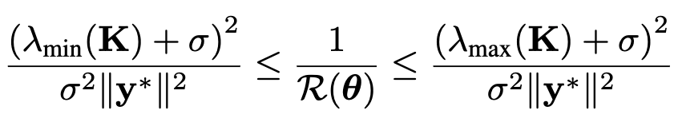



Proof of theorem 7
From Theorem 5, we already know
Also from theorem 6, we know how to bound the existing eigenvalues from K+S matrix’s eigenvalue. Therefore, we have
and
by combining the above inequalities, we have
Afzal, Zahra Rahimi, et al. "Linearization Explains Fine-Tuning in Large Language Models." The 39th Annual Conference on NeurIPS.
Notes:
지금부터는 theorem 7에 대한 proof를 살펴보겠습니다.
Theorem 5의 inequality에 역수를 취해주게 되면 다음을 우리가 알 수 있고, theorem 6로부터 K+S의 eigenvalue 값을 bound할 수 있음을 이미 알고 있습니다.
이 inequality들을 합하여 다음을 얻을 수 있습니다.

Slide 37
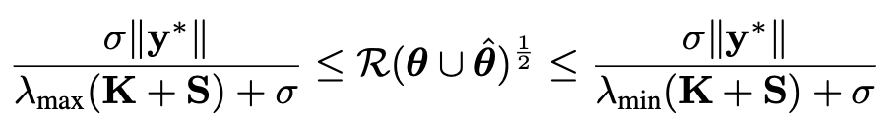
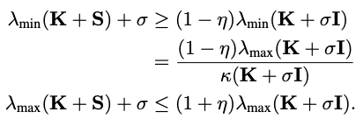

Proof of theorem 7
We will do the same thing on K+S case. From theorem 5, we have
and similarly, from theorem 6 we have
Therefore, combining these we have
Afzal, Zahra Rahimi, et al. "Linearization Explains Fine-Tuning in Large Language Models." The 39th Annual Conference on NeurIPS.
Notes:
K+S에 대해서도 동일한 과정을 해줄 수 있습니다. Theorem 5와 6를 통해 \theta hat을 추가했을 때 empirical risk를 bound해주는 과정입니다.

Slide 38
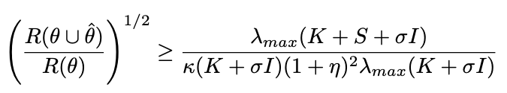
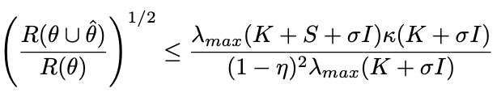
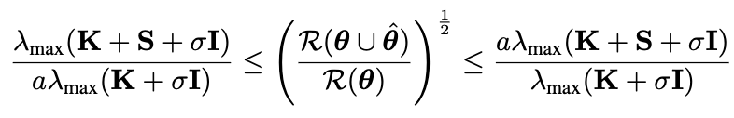

Proof of theorem 7
By combining two inequalities, we can obtain
and
Applying the $κ(K+σI) ≤c$, and suppose that $0 ≤ η ≤ 1$, then ${\left(1−η\right)}^{2}≤{\left(1+η\right)}^{−2}$ , by defining
$a = \frac{c}{{\left(1−η\right)}^{2}}$, we can have the desired form:
?
Afzal, Zahra Rahimi, et al. "Linearization Explains Fine-Tuning in Large Language Models." The 39th Annual Conference on NeurIPS.
Notes:
이 두가지 inequality를 합하고, condition number가 어떤 c로 바운드 되어있다고 하면 다음과 같이 theorem 7의 식을 얻을 수 있게 됩니다.
사실 여기서 저자가 별다른 언급 없이 \eta가 0과 1사이라고 가정하고 증명을 전개하는데, 사실 뭐 이 가정이 항상 성립하지는 않을 거라 생각하기는 하고,
또, c로 bound 해준 게 사실 의미가 있다기 보다는 그냥 애매한 term을 날려버리기 위해서 해준 것이라, 여러 의미로 조금 이상한 theorem인 것 같다는 생각이 있습니다.

Slide 39
Section 6 : Experiments
EECE695D : Deep Learning Theory

Slide 40
Experiments
What they show:
  Does the regularizer in fact make the model linear?
  Does the condition number on matrix K really bound the empirical risk?
Experiment setup:
  RoBERTa base fine-tuning task with LoRA
  Dataset: Binary classification (SST-2, CoLA, IMDb, Yelp)
Some notes:
  They transfer their findings into MSE to cross-entropy, and GD to AdamW.
  To fair comparison with other tasks, they converted Yelp dataset into binary classification
Afzal, Zahra Rahimi, et al. "Linearization Explains Fine-Tuning in Large Language Models." The 39th Annual Conference on NeurIPS.
Notes:
다음은 experiment section입니다. 여기서 저자들이 보인 것은 첫번째로 실제로 regulariezr가 model을 linear하게 만드는지와 matrix K의 condition number가 실제로 empirical risk와 관계가 있는 지를 보였습니다.
몇가지 참고하시면 좋은 사항은 저자들의 theoretical finding이 experiment에서는 조금 다르게 쓰였다는 점입니다. 가장 중요하게는 loss function이 바뀌었고, GD에서 AdamW로 optimizer 또한 변경되었습니다.

Slide 41
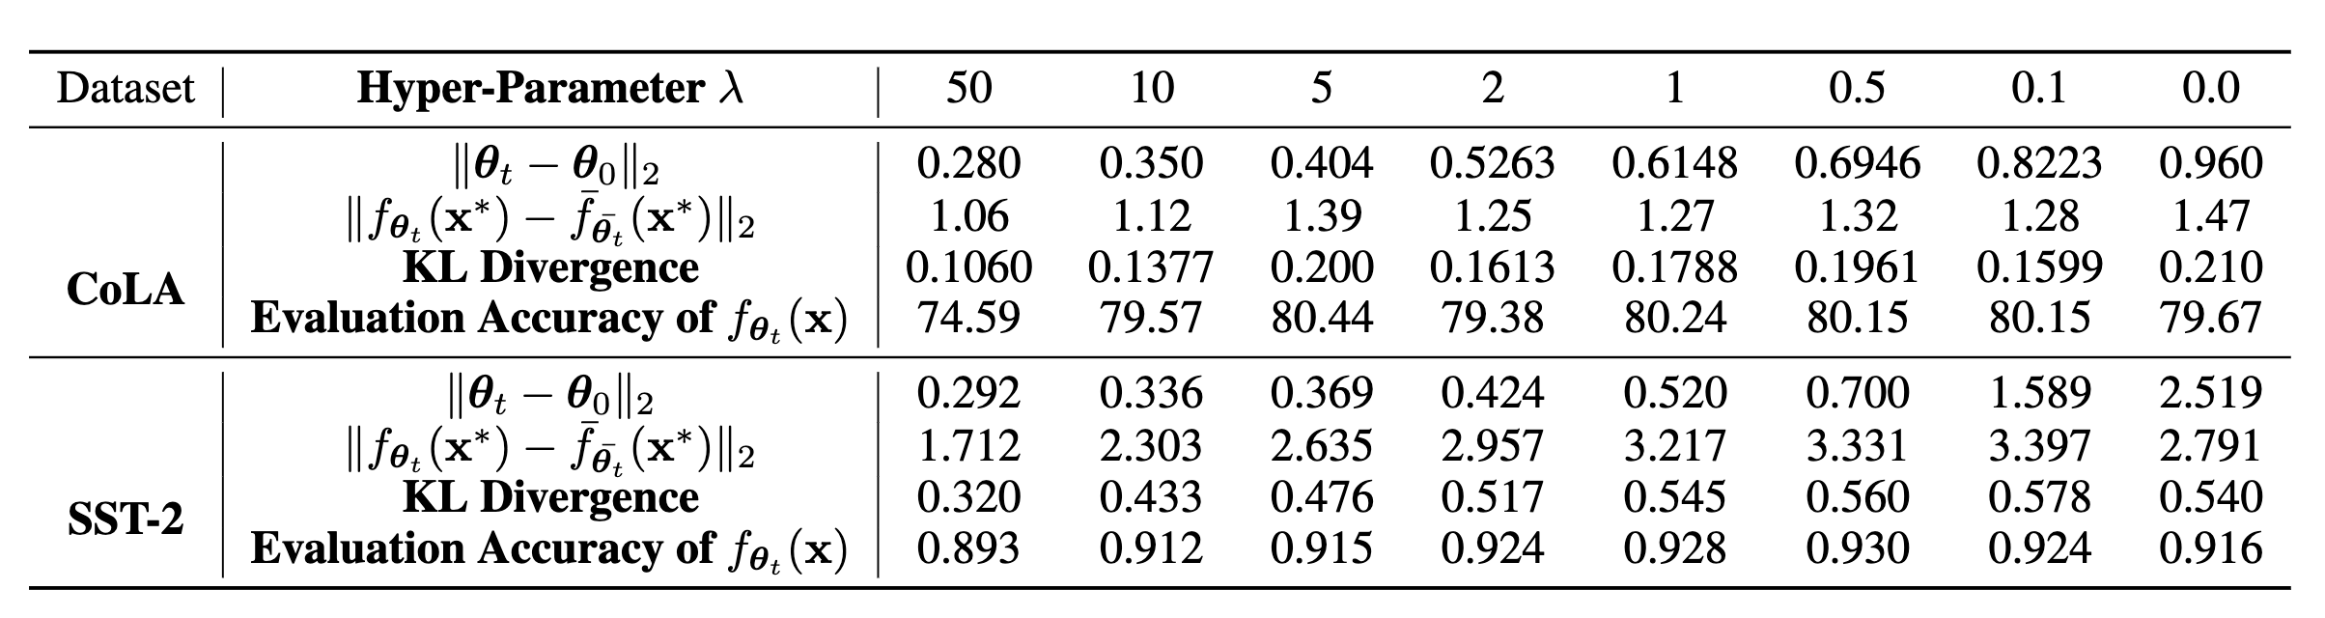
Does the regularizer in fact make the model linear?
As the regularization strength increases, the model behaves more like a linear model.
Afzal, Zahra Rahimi, et al. "Linearization Explains Fine-Tuning in Large Language Models." The 39th Annual Conference on NeurIPS.
Notes:
우선 regularizer가 실제로 model을 linear하게 만드는 지에 대한 실험입니다.
Regularizer의 영향력을 크게 조정해줄수록 linear model과의 output distance 및 KL divergence가 작아짐을 볼 수 있습니다.

Slide 42
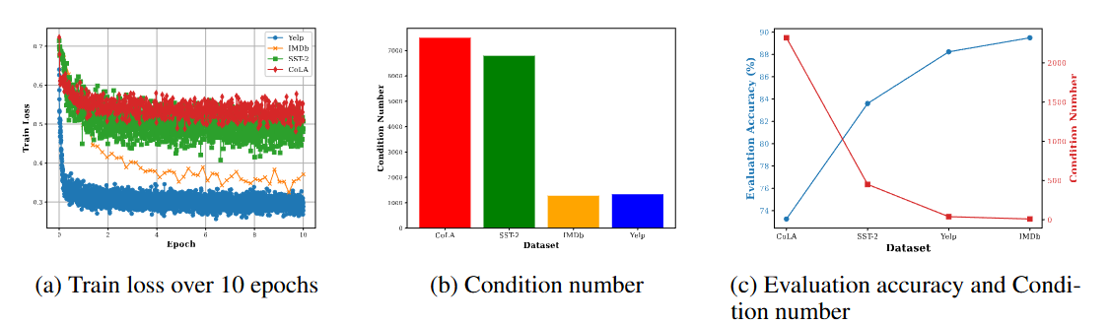
Does the condition number on matrix K really bound the empirical risk?
Higher condition number → Higher train loss
Afzal, Zahra Rahimi, et al. "Linearization Explains Fine-Tuning in Large Language Models." The 39th Annual Conference on NeurIPS.
Notes:
다음은 condition number가 empirical risk를 정말로 bound 하는지에 대한 실험입니다. (a)와 (b)를 보시면 condition number가 클수록 converge 했을 때의 train loss가 점점 커짐을 관찰할 수 있습니다.

Slide 43
Limitation
EECE695D : Deep Learning Theory

Slide 44
Limitation
Discrepancy between theoretical findings and experimental setup
Weak validation of the main assumption: fine-tuned parameters remain close to the initialization.
Unclear and weak support for the layer selection algorithm they propose.
Afzal, Zahra Rahimi, et al. "Linearization Explains Fine-Tuning in Large Language Models." The 39th Annual Conference on NeurIPS.

Slide 45
End of Document
EECE695D : Deep Learning Theory

Slide 46

Lemma 3. Gradient Flow
Let $θ_{t}$ be the gradient flow limit of the regularized fine-tuning gradient descent described above. If we assume that $λ$ switches at most countably often and denote instantaneous value by $λ_{t}$, the $θ_{t}$ satisfies the following differential equation
$$\frac{d}{dt}θ_{t}=−∇_{θ}\tilde{R}{\left(θ_{t}\right)}^{⏉}−λ_{t}(θ_{t}−θ_{0})$$
Gradient descent on regularization term : $θ_{t}={\tilde{θ}}_{t} −λη\left({\tilde{θ}}_{t}−θ_{0}\right) →θ_{t}−θ_{0}={\tilde{θ}}_{t}−θ_{0} −λη\left({\tilde{θ}}_{t}−θ_{0}\right)$
Modified regularization step : $θ_{t}=\{\begin{matrix}{\tilde{θ}}_{t} −λη\left({\tilde{θ}}_{t}−θ_{0}\right) if ∇_{θ}\tilde{R}\left(θ_{t}\right)\left(θ_{t}−θ_{0}\right)≥0 \\ {\tilde{θ}}_{t} if{ ∇}_{θ}\tilde{R}\left(θ_{t}\right)\left(θ_{t}−θ_{0}\right)<0\end{matrix}$
  $θ_{t}=θ_{0}+\left(1−λ_{t}η\right)\left({\tilde{θ}}_{t}−θ_{0}\right) where λ_{t}=\{\begin{matrix}λ if ∇_{θ}\tilde{R}\left(θ_{t}\right)\left(θ_{t}−θ_{0}\right)≥0 \\ 0 if{ ∇}_{θ}\tilde{R}\left(θ_{t}\right)\left(θ_{t}−θ_{0}\right)<0\end{matrix}$
$θ_{t+1}=θ_{t}−η∇\tilde{R}{\left(θ_{t}\right)}^{⏉}−λ_{t+1}η\left({\tilde{θ}}_{t+1}−θ_{0}\right)$
$=θ_{t}−η∇\tilde{R}{\left(θ_{t}\right)}^{⏉}−\frac{λ_{t+1}η}{1−λ_{t+1}η}\left(θ_{t+1}−θ_{0}\right) (∵{\tilde{θ}}_{t+1}−θ_{0}=\frac{λ_{t+1}η}{1−λ_{t+1}η}\left(θ_{t+1}−θ_{0}\right))$
$θ_{t+1}=\left(1−λ_{t+1}η\right)\left(θ_{t}−η∇\tilde{R}{\left(θ_{t}\right)}^{⏉}+\frac{λ_{t+1}η}{1−λ_{t+1}η}θ_{0}\right)=\left(1−λ_{t+1}η\right)θ_{t}−η\left(1−λ_{t+1}η\right)∇\tilde{R}{\left(θ_{t}\right)}^{⏉}+λ_{t+1}ηθ_{0}$
$\frac{θ_{t+1}−θ_{t}}{η}=−λ_{t+1}θ_{t}−\left(1−λ_{t+1}η\right)∇\tilde{R}{\left(θ_{t}\right)}^{⏉}+λ_{t+1}ηθ_{0} → \lim_{η→0}{\frac{θ_{t+1}−θ_{t}}{η}}=\frac{d}{dt}θ_{t}=−∇_{θ}\tilde{R}{\left(θ_{t}\right)}^{⏉}−λ_{t}(θ_{t}−θ_{0})$
Afzal, Zahra Rahimi, et al. "Linearization Explains Fine-Tuning in Large Language Models." The 39th Annual Conference on NeurIPS.

Slide 47

Lemma 1. Norm Bounds and Lipschitzness
Consider the selectively regularized fine-tuning solution, under the squared loss. Denote the instantaneous value of the regularization parameter by $λ_{t}$, which can be either 0 or $λ$. If $f_{θ}\left(x^{∗}\right)$ is $Lip\left(f\right)−Lipschitz$ in an $l_{2}−ball$ of radius $τ$ around pretrained parameters $θ_{0}$,
$\left\|θ−θ_{0}\right\|≤2 Lip\left(f\right)\left\|f_{θ_{t}}\left(x^{∗}\right)−y^{∗}\right\|\int_{0}^{t}{e^{−\left(Λ_{t}−Λ_{s}\right)}ds},$ where $Λ_{t}=\int_{0}^{t}{λ_{s}ds}$
$∇_{θ}\tilde{R}\left(θ_{t}\right)=2{\left(y\left(t\right)−y^{∗}\right)}^{⏉}∇f_{θ_{t}}\left(x^{∗}\right)$
$\frac{d}{dt}θ_{t}=−∇_{θ}\tilde{R}{\left(θ_{t}\right)}^{⏉}−λ_{t}\left(θ_{t}−θ_{0}\right)=−2∇f_{θ_{t}}{\left(x^{∗}\right)}^{⏉}\left(y\left(t\right)−y^{∗}\right)−λ_{t}\left(θ_{t}−θ_{0}\right)$
$\frac{d}{dt}u_{t}=−2∇f_{θ_{t}}{\left(x^{∗}\right)}^{⏉}\left(y\left(t\right)−y^{∗}\right)−λ_{t}u_{t}$ where $u_{t}=\left(θ_{t}−θ_{0}\right)$
Afzal, Zahra Rahimi, et al. "Linearization Explains Fine-Tuning in Large Language Models." The 39th Annual Conference on NeurIPS.

Slide 48

Theorem 4.
Under the squared loss, if $f_{θ_{t}}\left(x^{∗}\right)$ and $∇f_{θ_{t}}\left(x^{∗}\right)$ are $Lip\left(f\right)−Lipschitz$ and $Lip\left(∇f\right)−Lipschitz$ in an $l_{2}−ball$ of radius $τ$ around pretrained parameters $θ_{0}.$
Define $λ_{∘}=\frac{2\left\|f_{θ_{0}}\left(x^{∗}\right)−y^{∗}\right\|Lip(f)}{r}$
If $λ≥λ_{∘}$, then for all $t$, the following holds
If $λ<λ_{∘}$, then the following holds for $t≤\frac{1}{λ}ln(\frac{1}{1−λ/λ_{∘}})$
In particular, for $λ≥λ_{∘}$, the bound from theorem 3 always holds and simplifies to
$\left\|f_{θ_{t}}\left(x^{∗}\right)−{\overline{f}}_{{\overline{θ}}_{t}}(x^{∗})\right\|≤2Lip\left(f\right)\tilde{R}\left(θ_{0}\right)\left(2rLip\left(∇f\right)+Lip\left(f\right)\right)t$
Theorem 2 : $\left\|θ_{t}−θ_{0}\right\|≤\frac{2\left\|y\left(0\right)−y^{∗}\right\|Lip\left(f\right)}{λ}\left(1−e^{−λt}\right)$
In order for the regularizer to satisfy the Lipschitz continuity assumptions, mainly that $\left\|θ_{t}−θ_{0}\right\|≤r$, this shows that there are two phases of behavior depending on how large $λ$ is, where the threshold is given by $λ_{∘}=\frac{2\left\|f_{θ_{0}}\left(x^{∗}\right)−y^{∗}\right\|Lip(f)}{r}$
In particular, if $λ≥λ_{∘}$, then $θ_{t}$ remains in the $r$-ball around $θ_{0}$ for all $t$. Otherwise, it remains in this ball only as long as $t≤\frac{1}{λ}ln(\frac{1}{1−λ/λ_{∘}})$
Afzal, Zahra Rahimi, et al. "Linearization Explains Fine-Tuning in Large Language Models." The 39th Annual Conference on NeurIPS.

Slide 49

Theorem 4.
Under the squared loss, if $f_{θ_{t}}\left(x^{∗}\right)$ and $∇f_{θ_{t}}\left(x^{∗}\right)$ are $Lip\left(f\right)−Lipschitz$ and $Lip\left(∇f\right)−Lipschitz$ in an $l_{2}−ball$ of radius $τ$ around pretrained parameters $θ_{0}.$
Define $λ_{∘}=\frac{2\left\|f_{θ_{0}}\left(x^{∗}\right)−y^{∗}\right\|Lip(f)}{r}$
If $λ≥λ_{∘}$, then for all $t$, the following holds
If $λ<λ_{∘}$, then the following holds for $t≤\frac{1}{λ}ln(\frac{1}{1−λ/λ_{∘}})$
In particular, for $λ≥λ_{∘}$, the bound from theorem 3 always holds and simplifies to
$\left\|f_{θ_{t}}\left(x^{∗}\right)−{\overline{f}}_{{\overline{θ}}_{t}}(x^{∗})\right\|≤2Lip\left(f\right)\tilde{R}\left(θ_{0}\right)\left(2rLip\left(∇f\right)+Lip\left(f\right)\right)t$
Based on Theorem 3, we get that
$∆\left(t\right)≤2Lip{\left(f\right)}^{2}\left\|f_{θ_{0}}\left(x^{∗}\right)−y^{∗}\right\|(\frac{4}{λ}Lip\left(∇f\right)\left\|f_{θ_{0}}\left(x^{∗}\right)−y^{∗}\right\|+1)(t+\frac{1}{λ}e^{−λt}−\frac{1}{λ})$
When $λ≥λ_{∘}$, $∆\left(t\right)$ grows linearly, with coefficient given by
$∆\left(t\right)≤2Lip(f)$ $\left\|y(0)−y^{∗}\right\|$ $\left(2rLip\left(∇f\right)+Lip\left(f\right)\right)t$
Afzal, Zahra Rahimi, et al. "Linearization Explains Fine-Tuning in Large Language Models." The 39th Annual Conference on NeurIPS.

